Slide 1
Website Proof reading 2

Slide 2
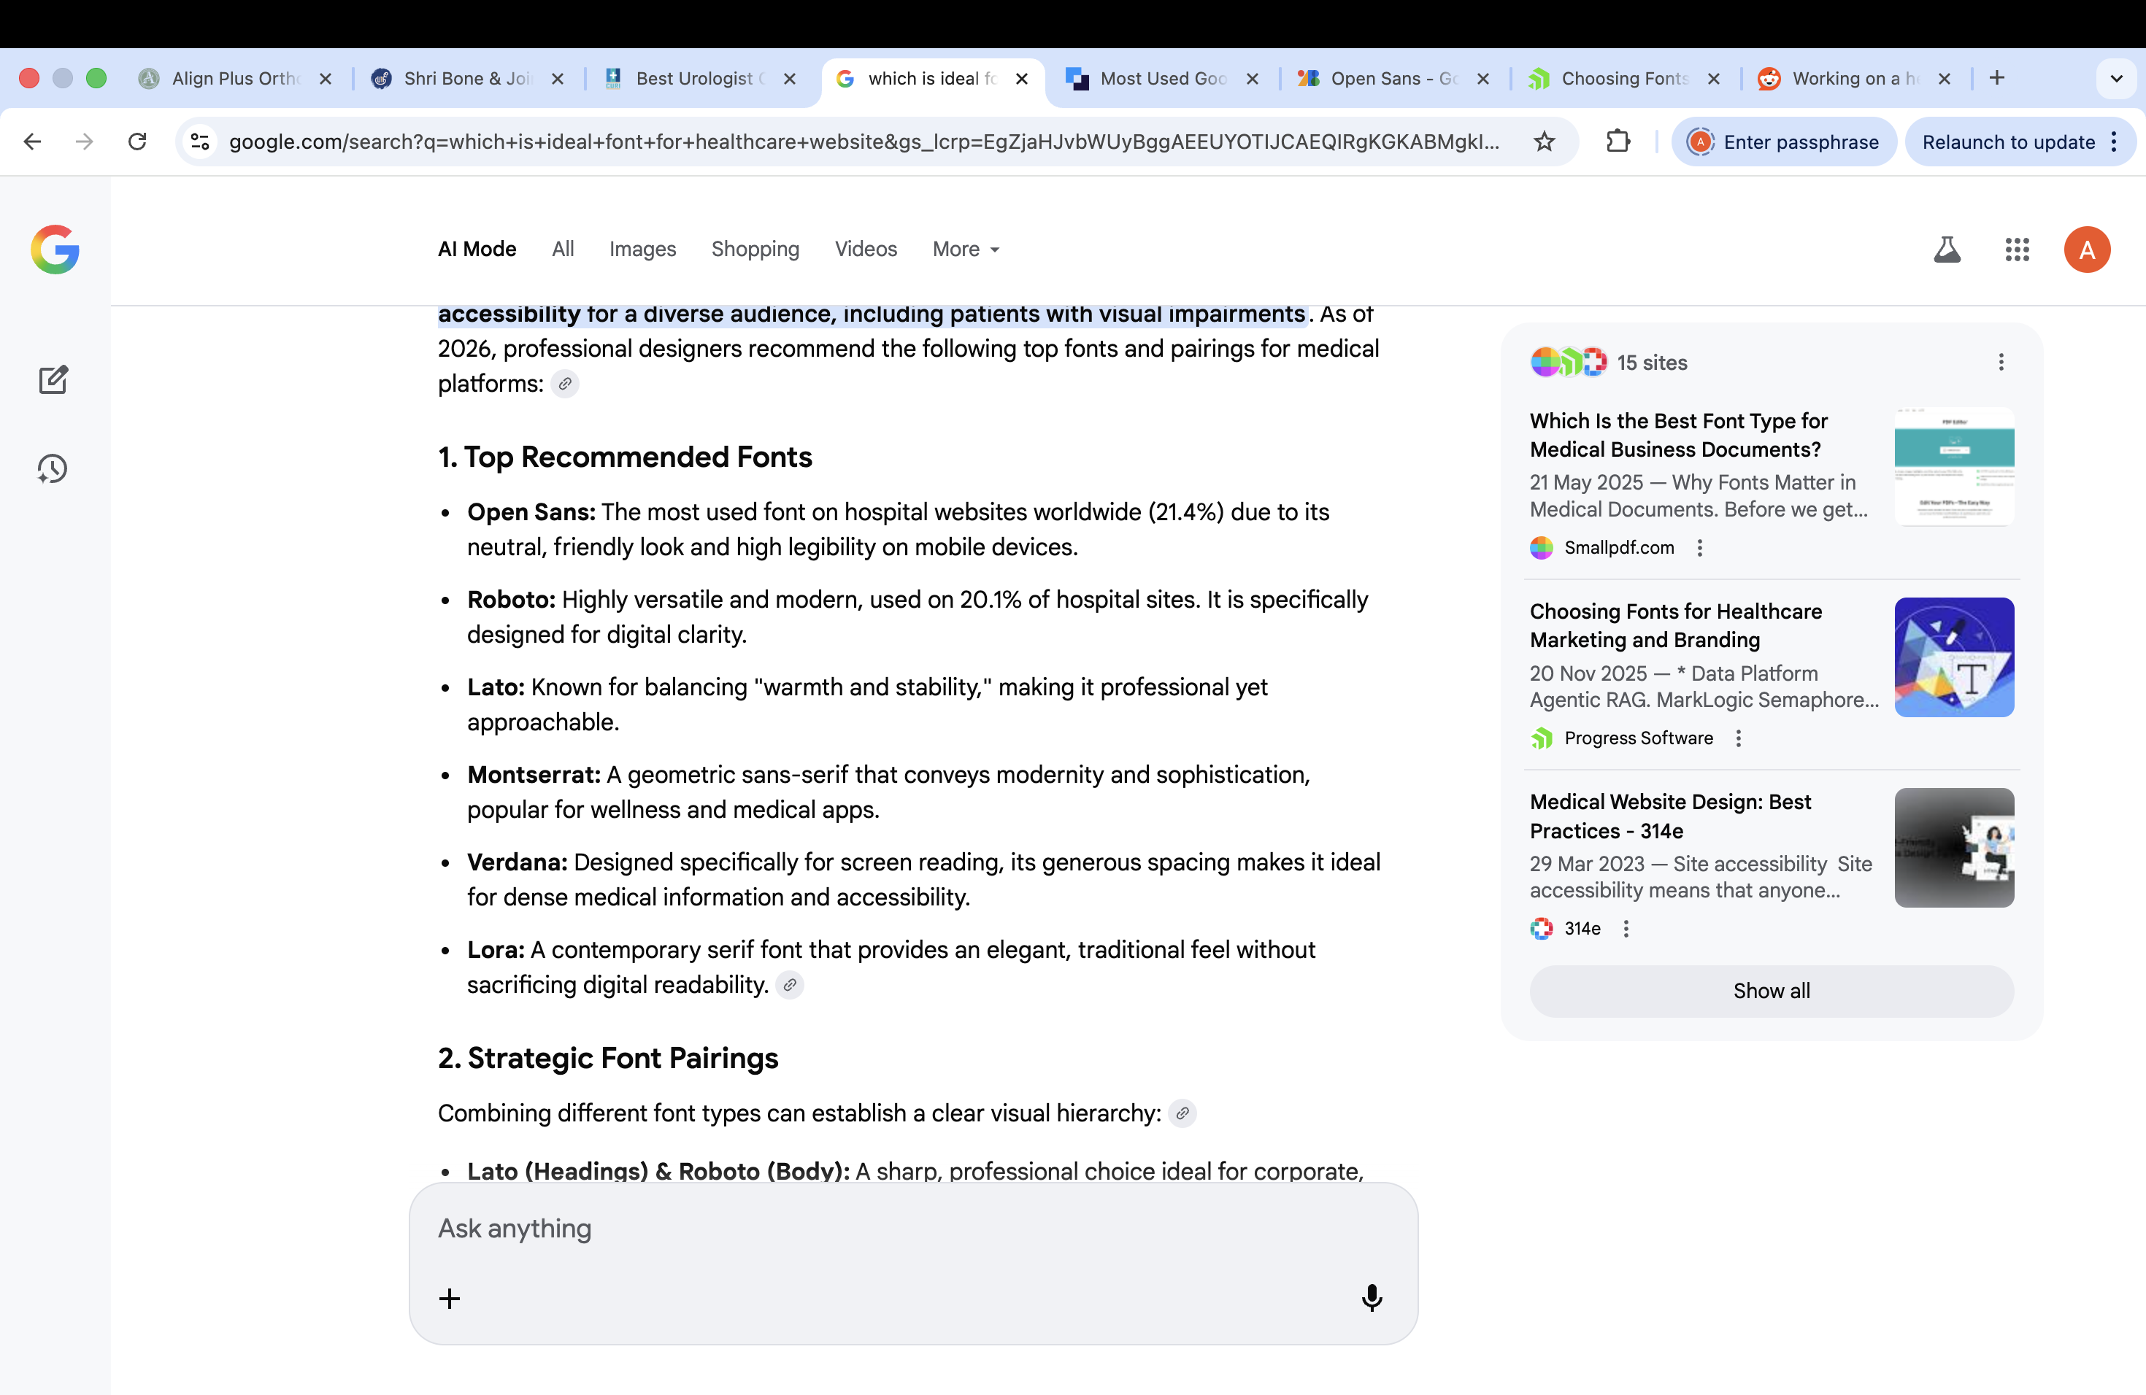
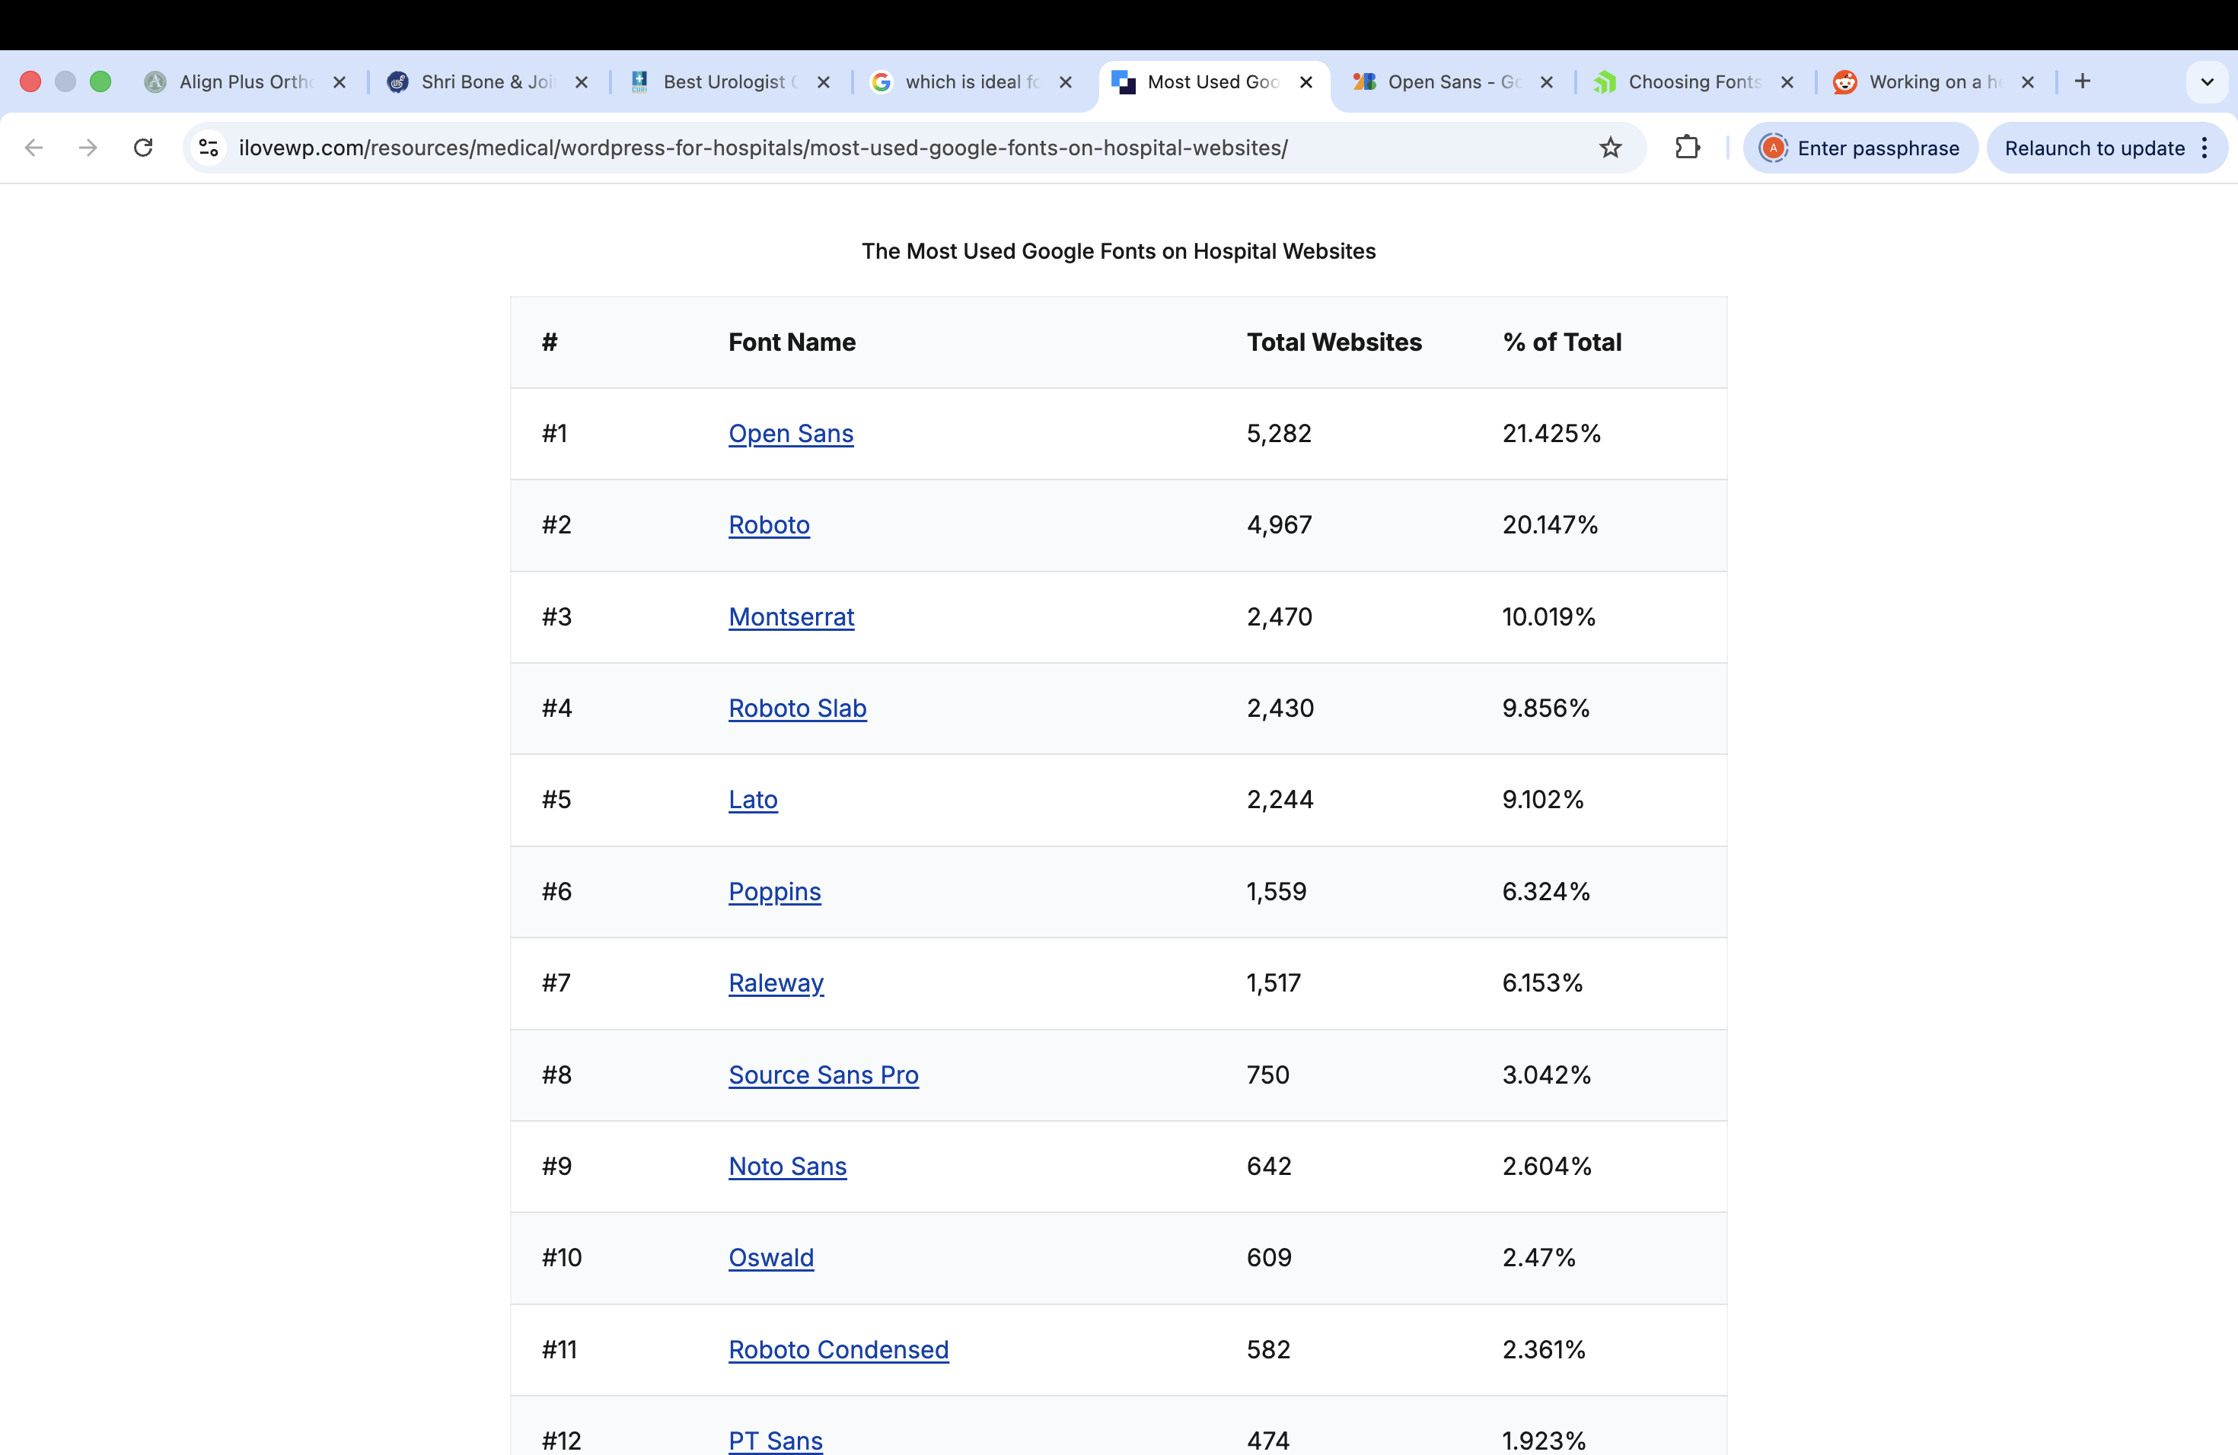
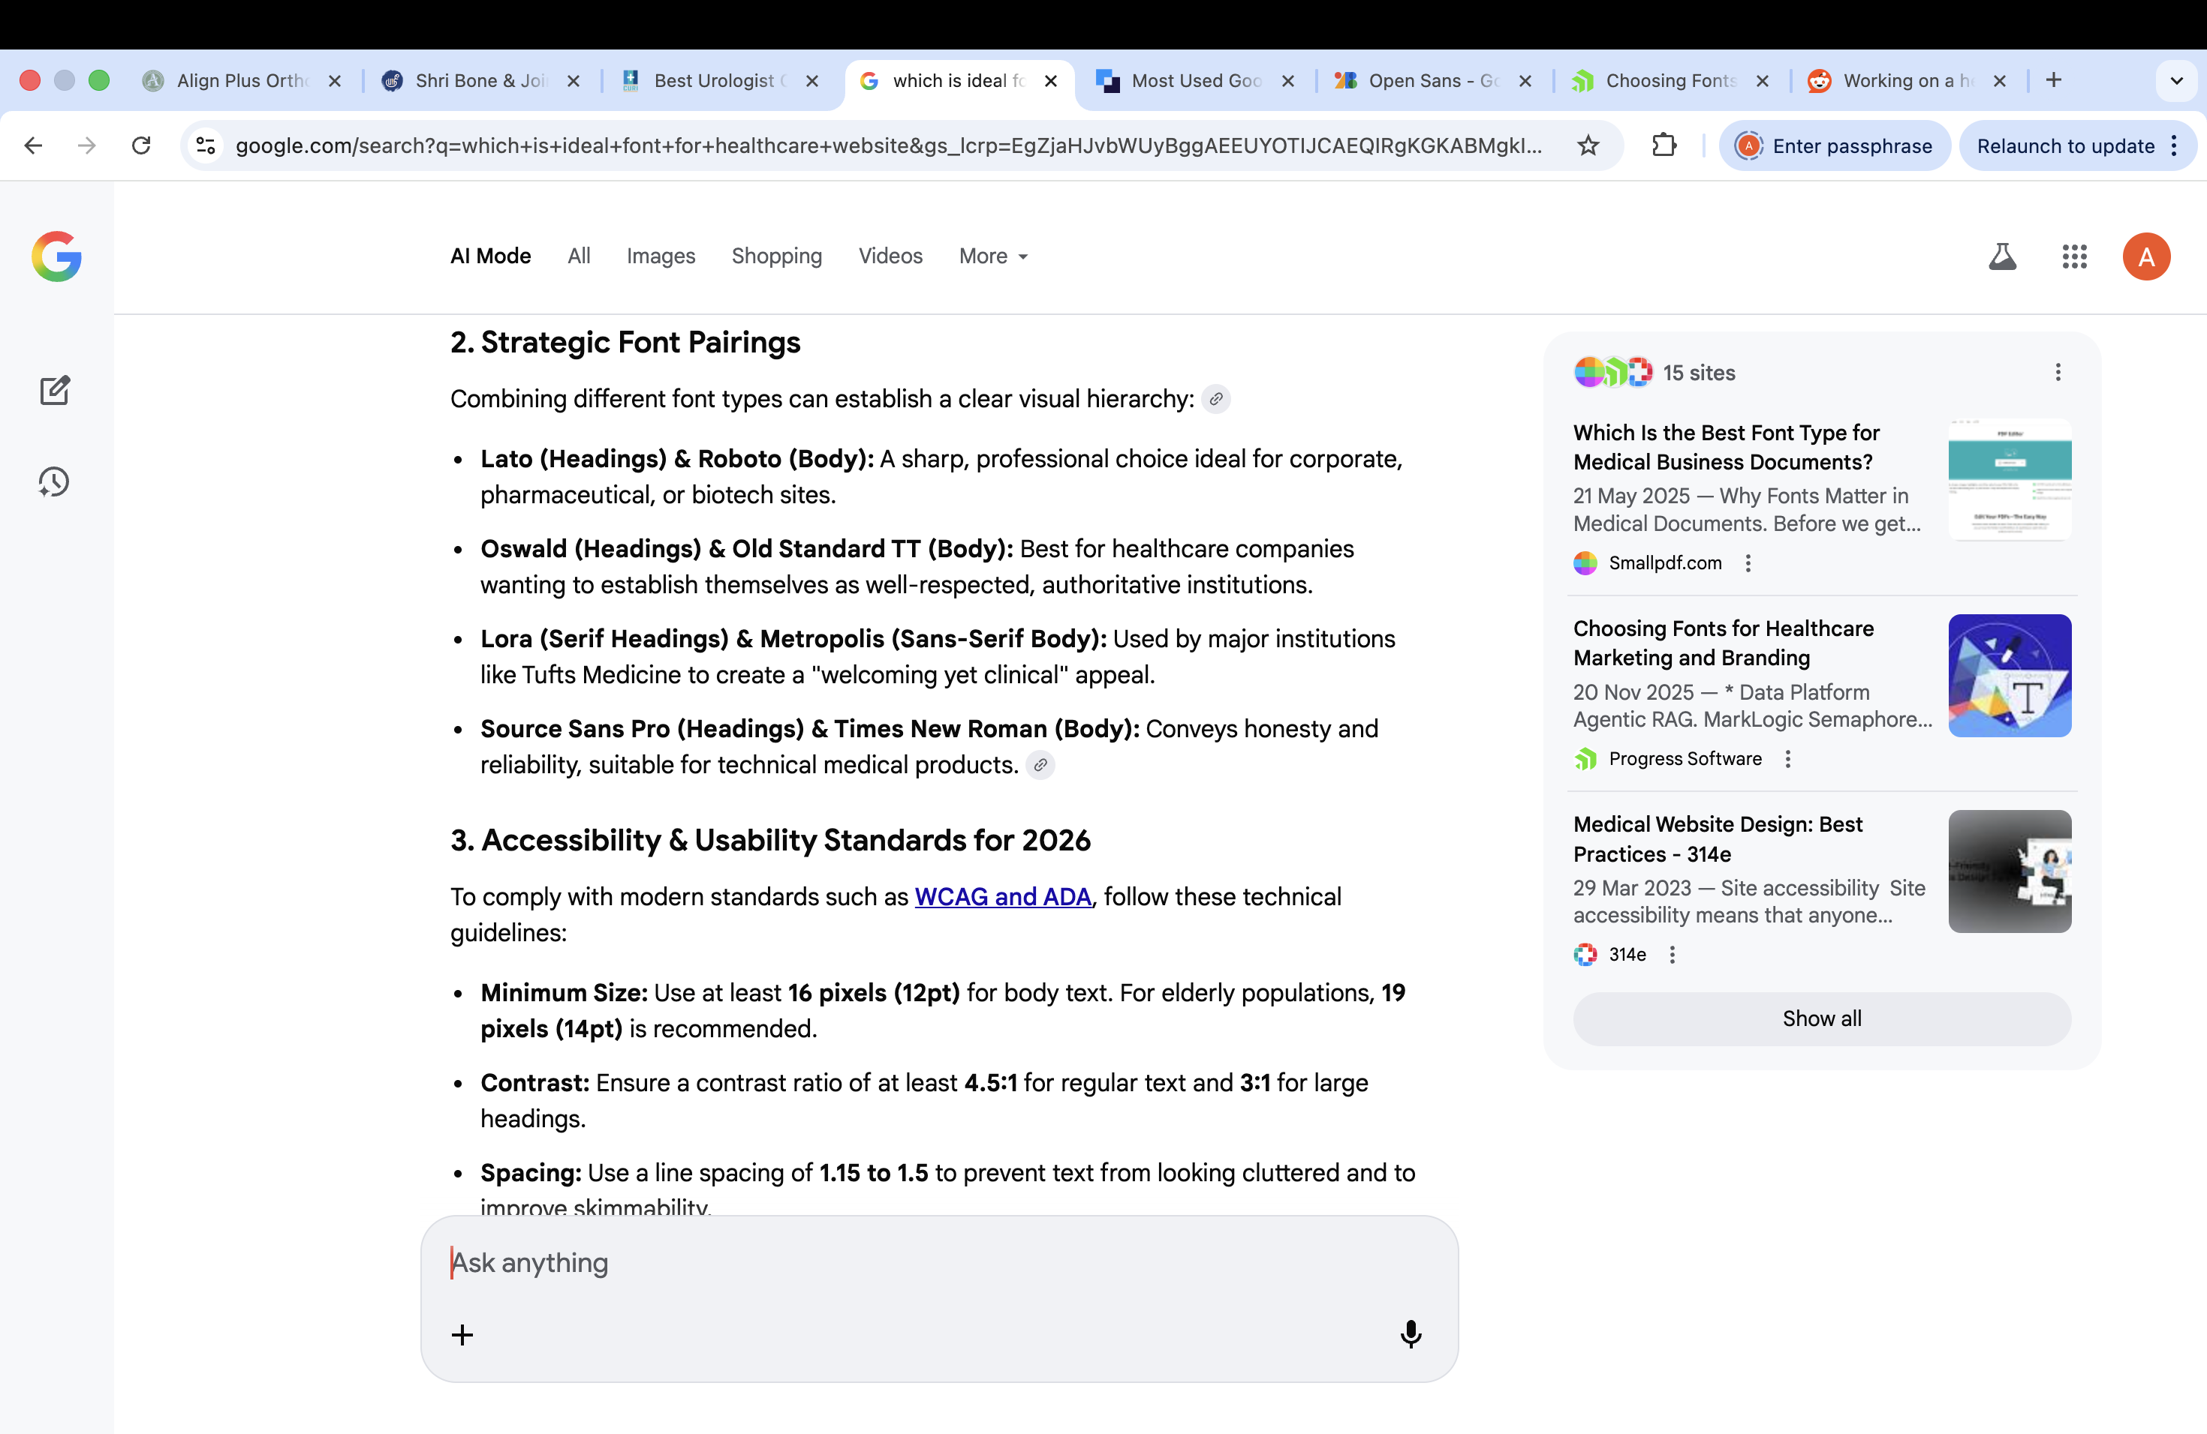
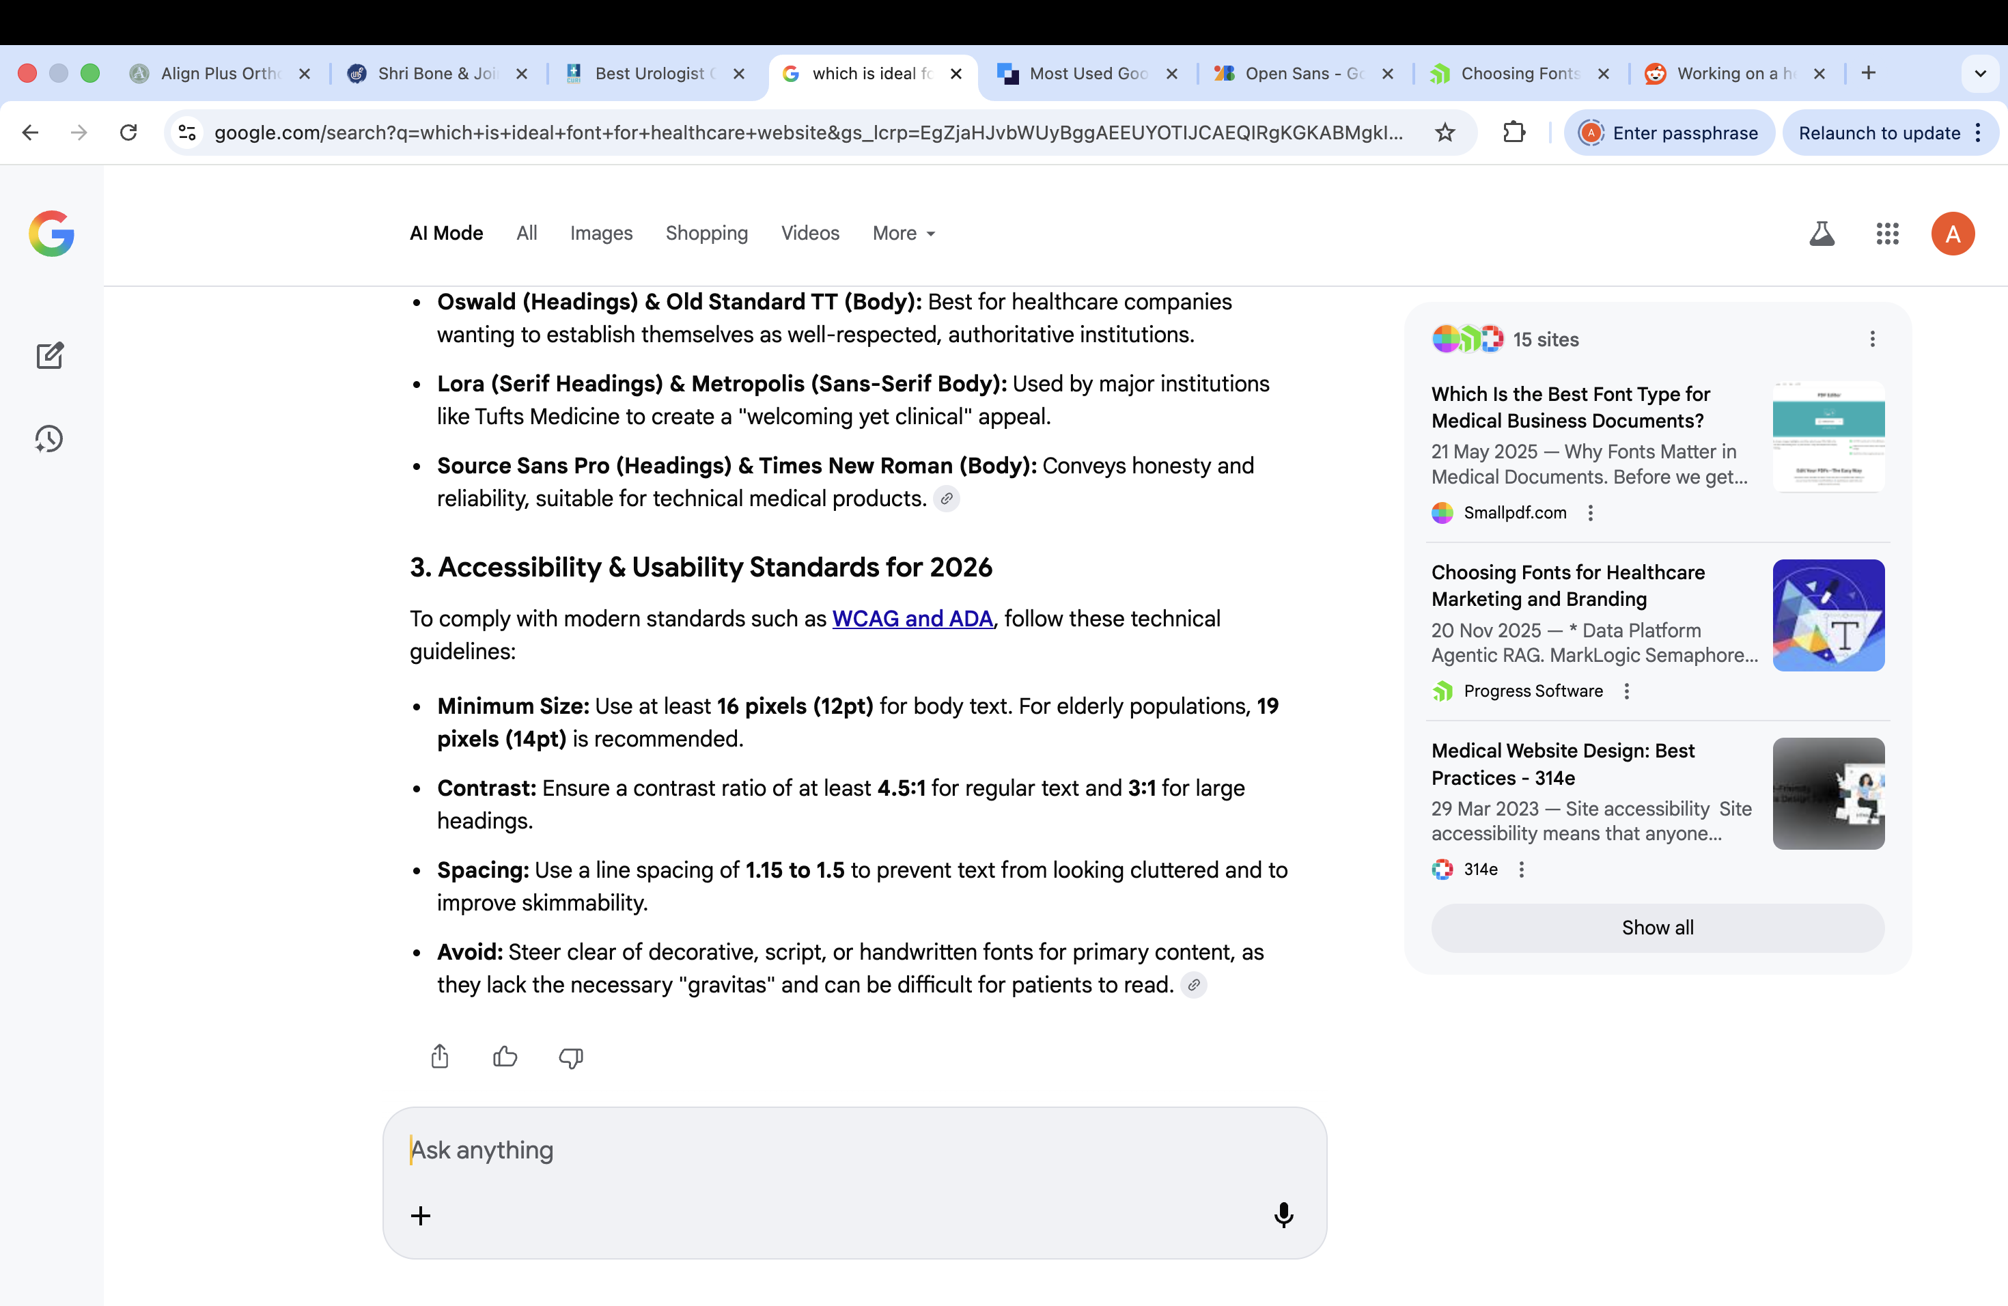

Slide 3
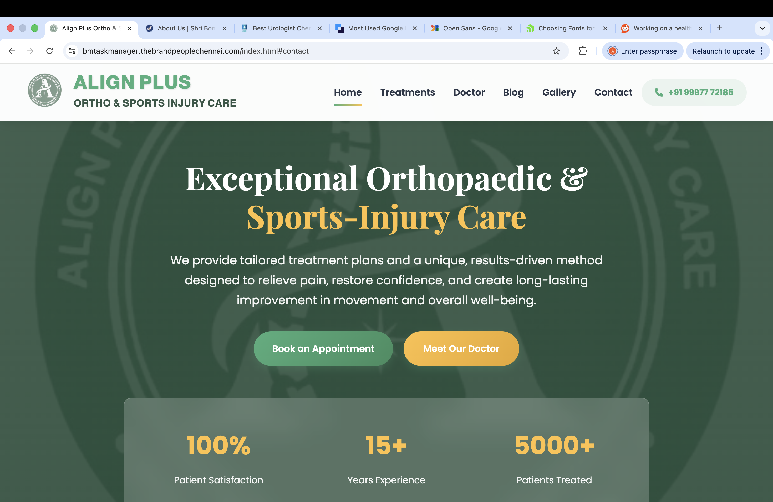
1.Logo Size
2.Align plus – Position
3.Background logo
4.Colour
5.Font – Heading & Body
6.Social media link – Ref CURI website
7.Any language – Ref CURI website
8.Slide show

Slide 4
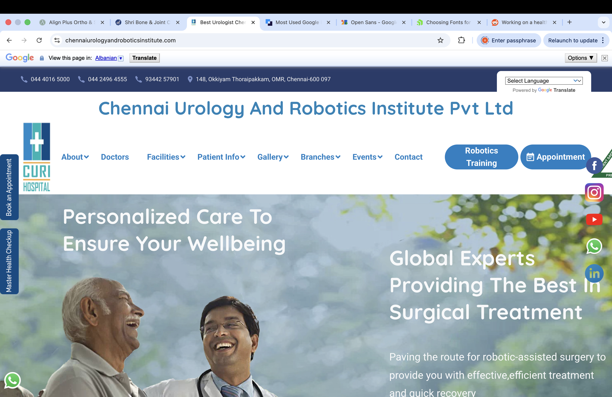

Slide 5
In treatment
Please include about weight loss journey also

Slide 6
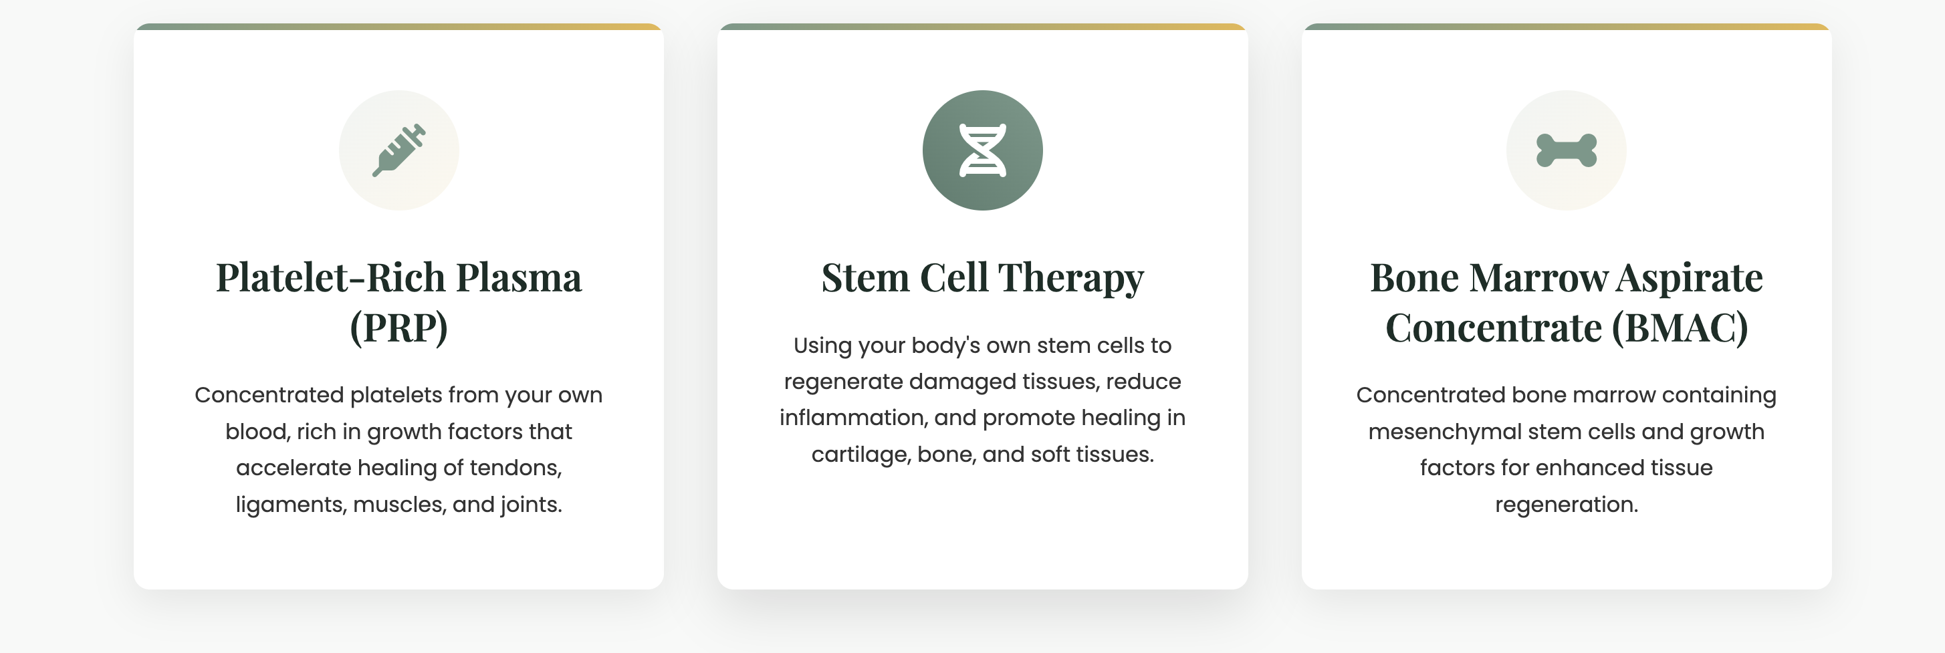
Here, we need to add about SVF(Stromal vascular fraction) fat also

Slide 7
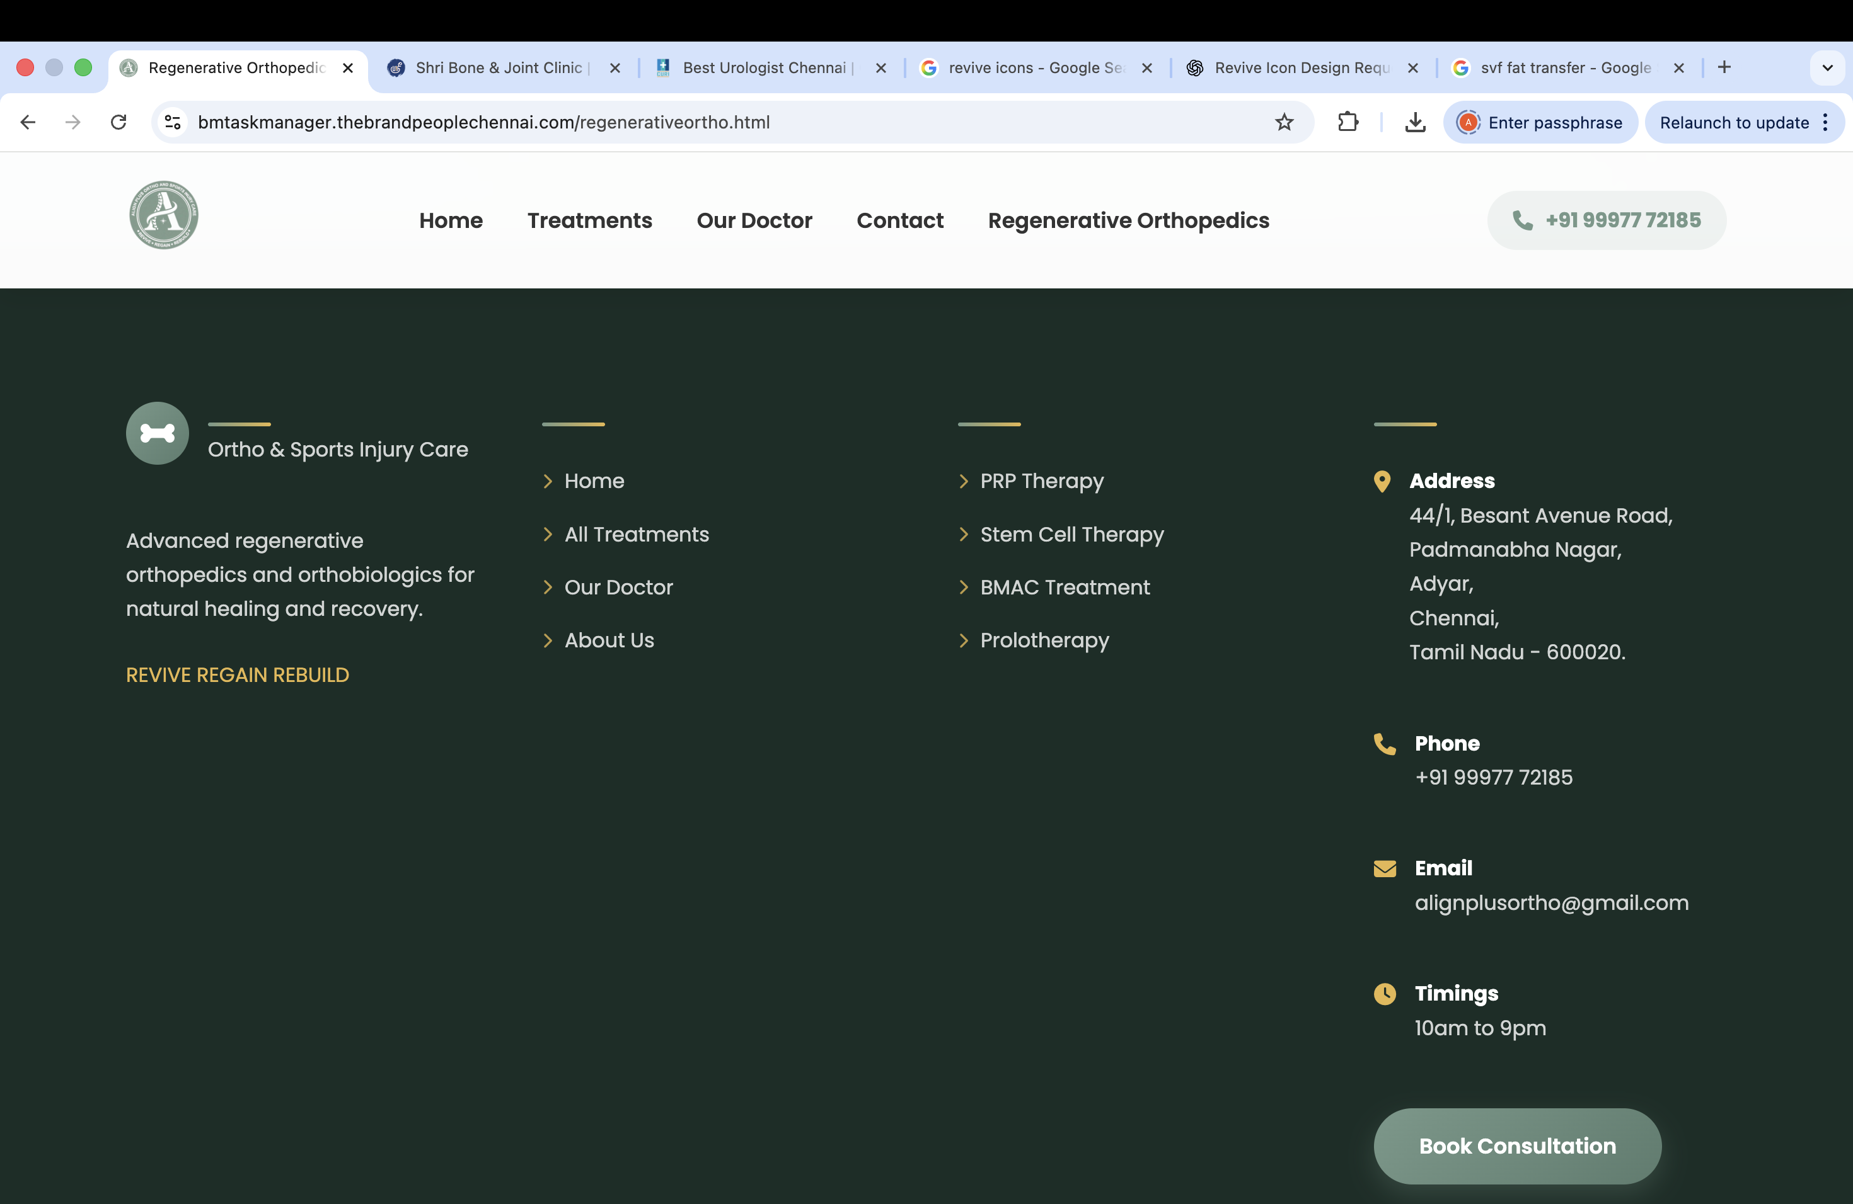
Timings
Physiotherapy & Sports Rehab, Lab Services
9am to 9pm
Orthopedic Doctor consultation
3pm to 9pm
Remove prolotherapy

Slide 8
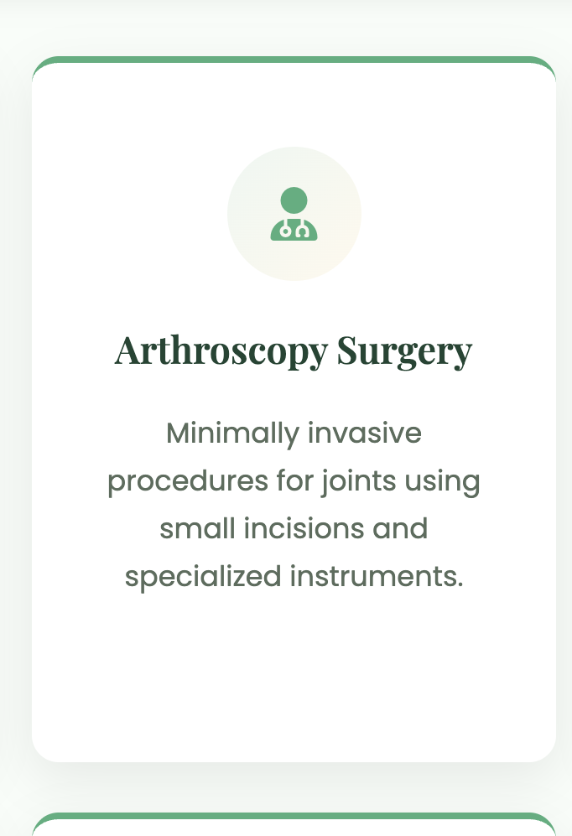
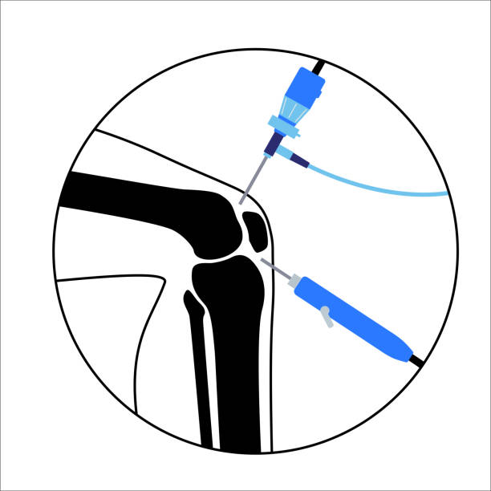
Arthroscopy / Nanoscopy Surgery
Use this clip art

Slide 9
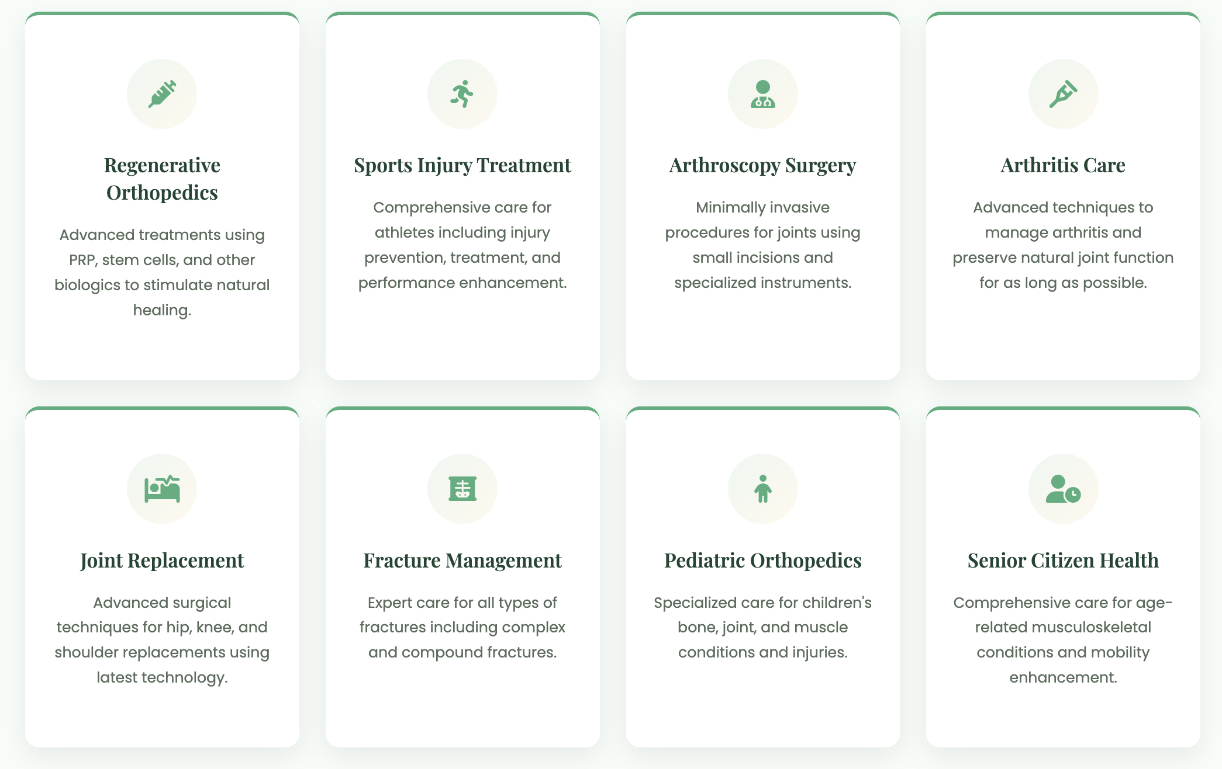
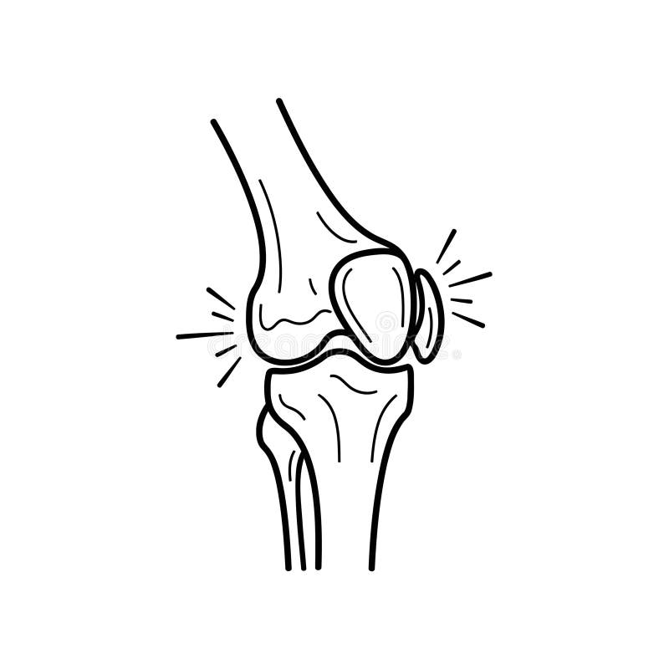

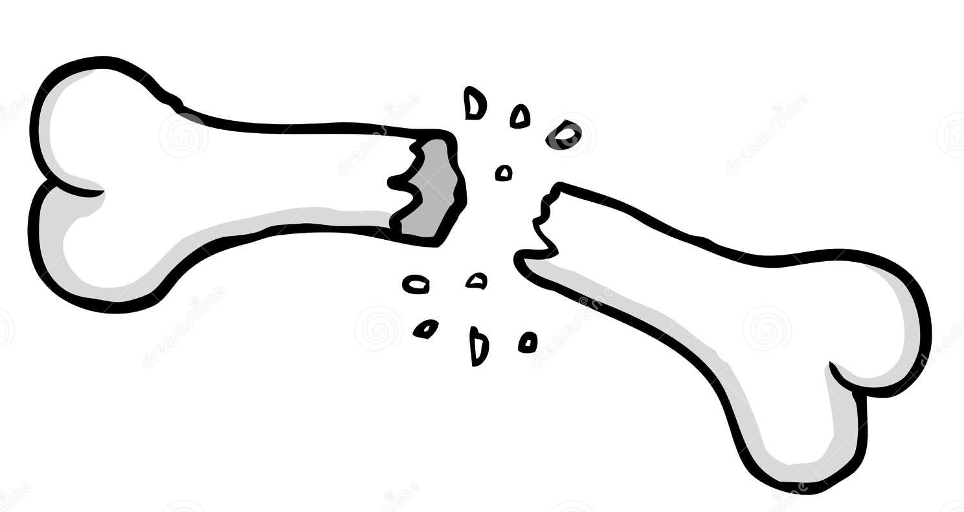
Arthroscopy
Arthritis Care
Joint replacement
Fracture Management

Slide 10
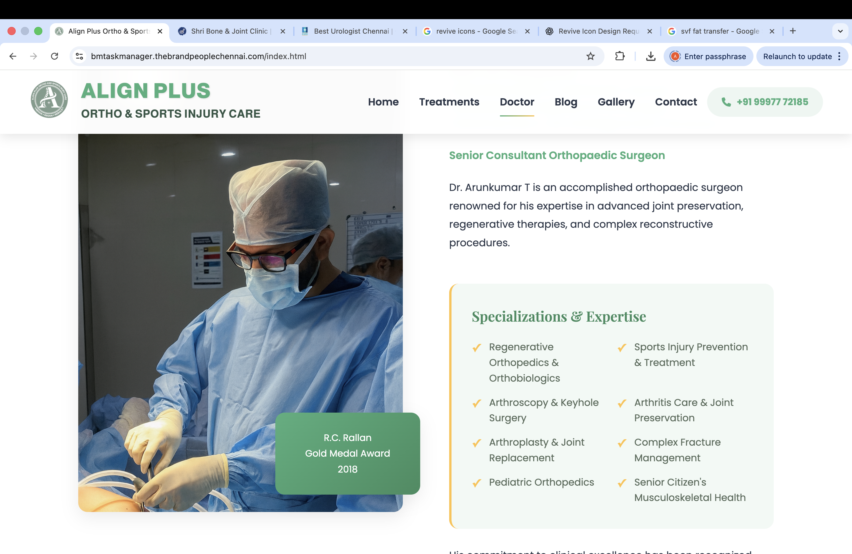
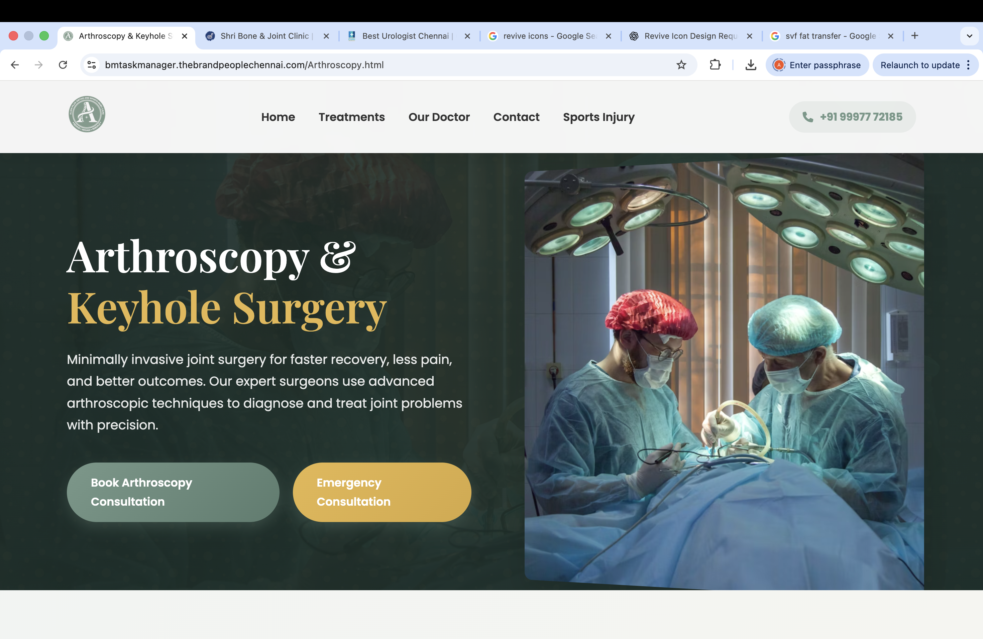
I think we can use my picture here

Slide 11
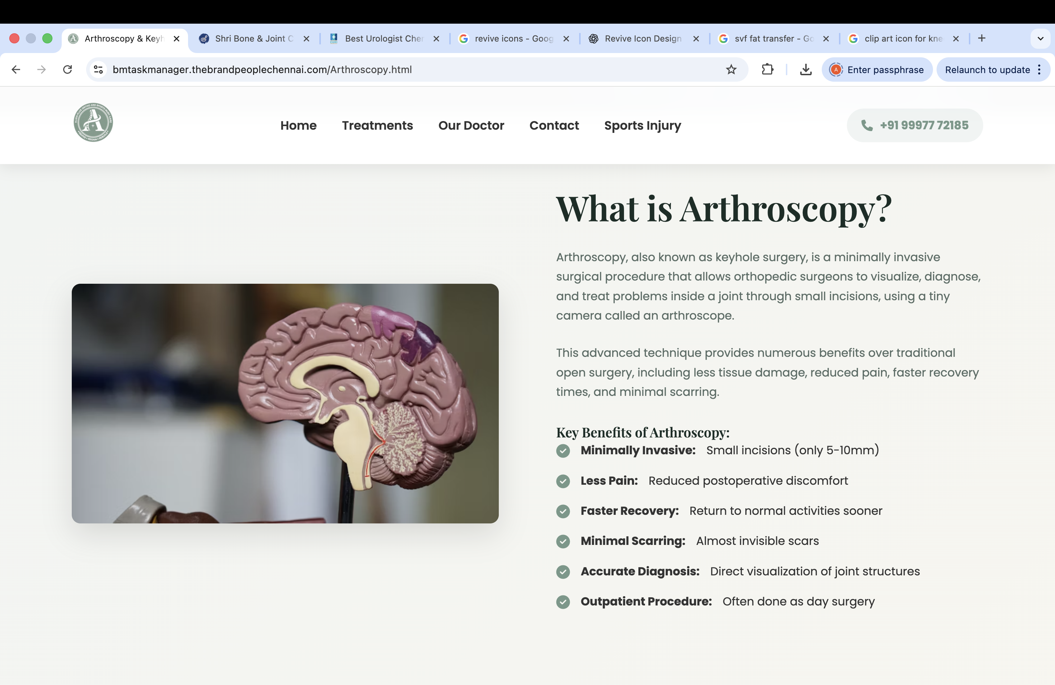
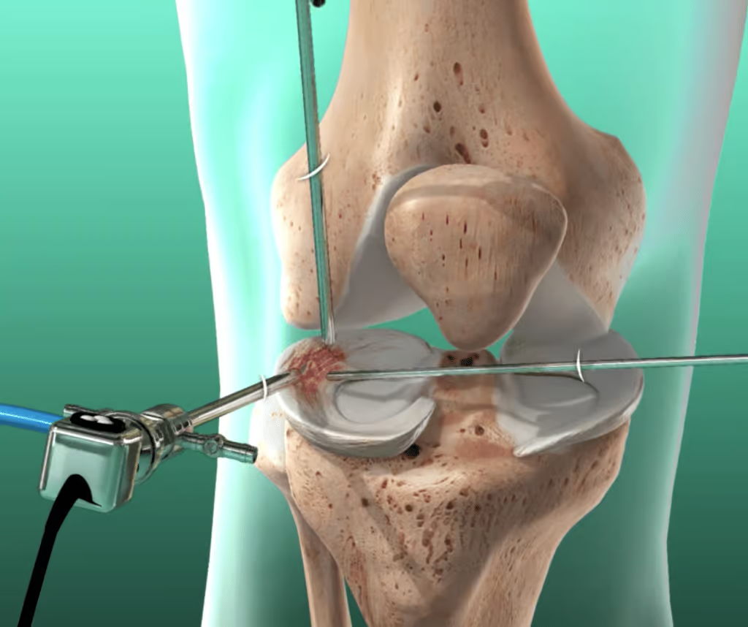
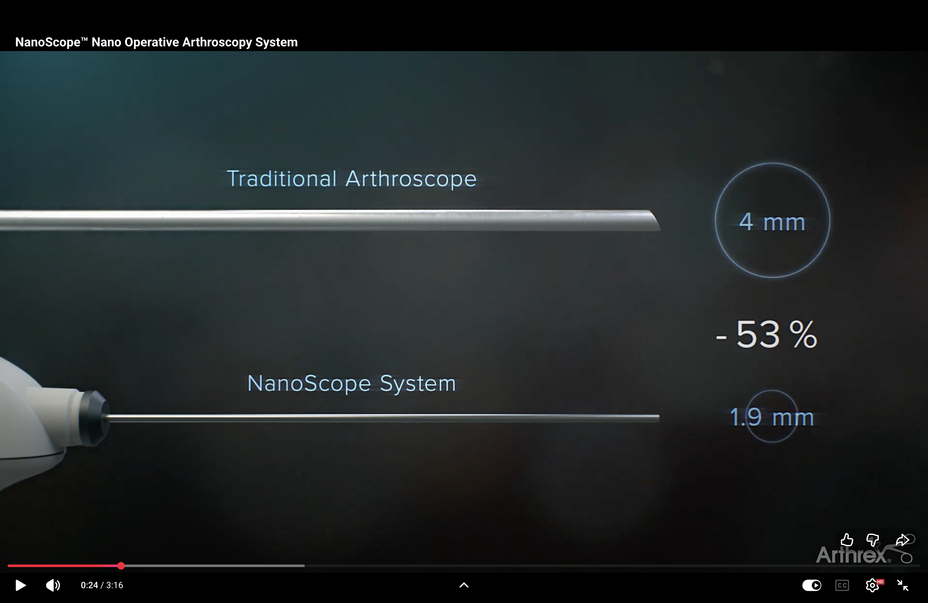

Slide 12
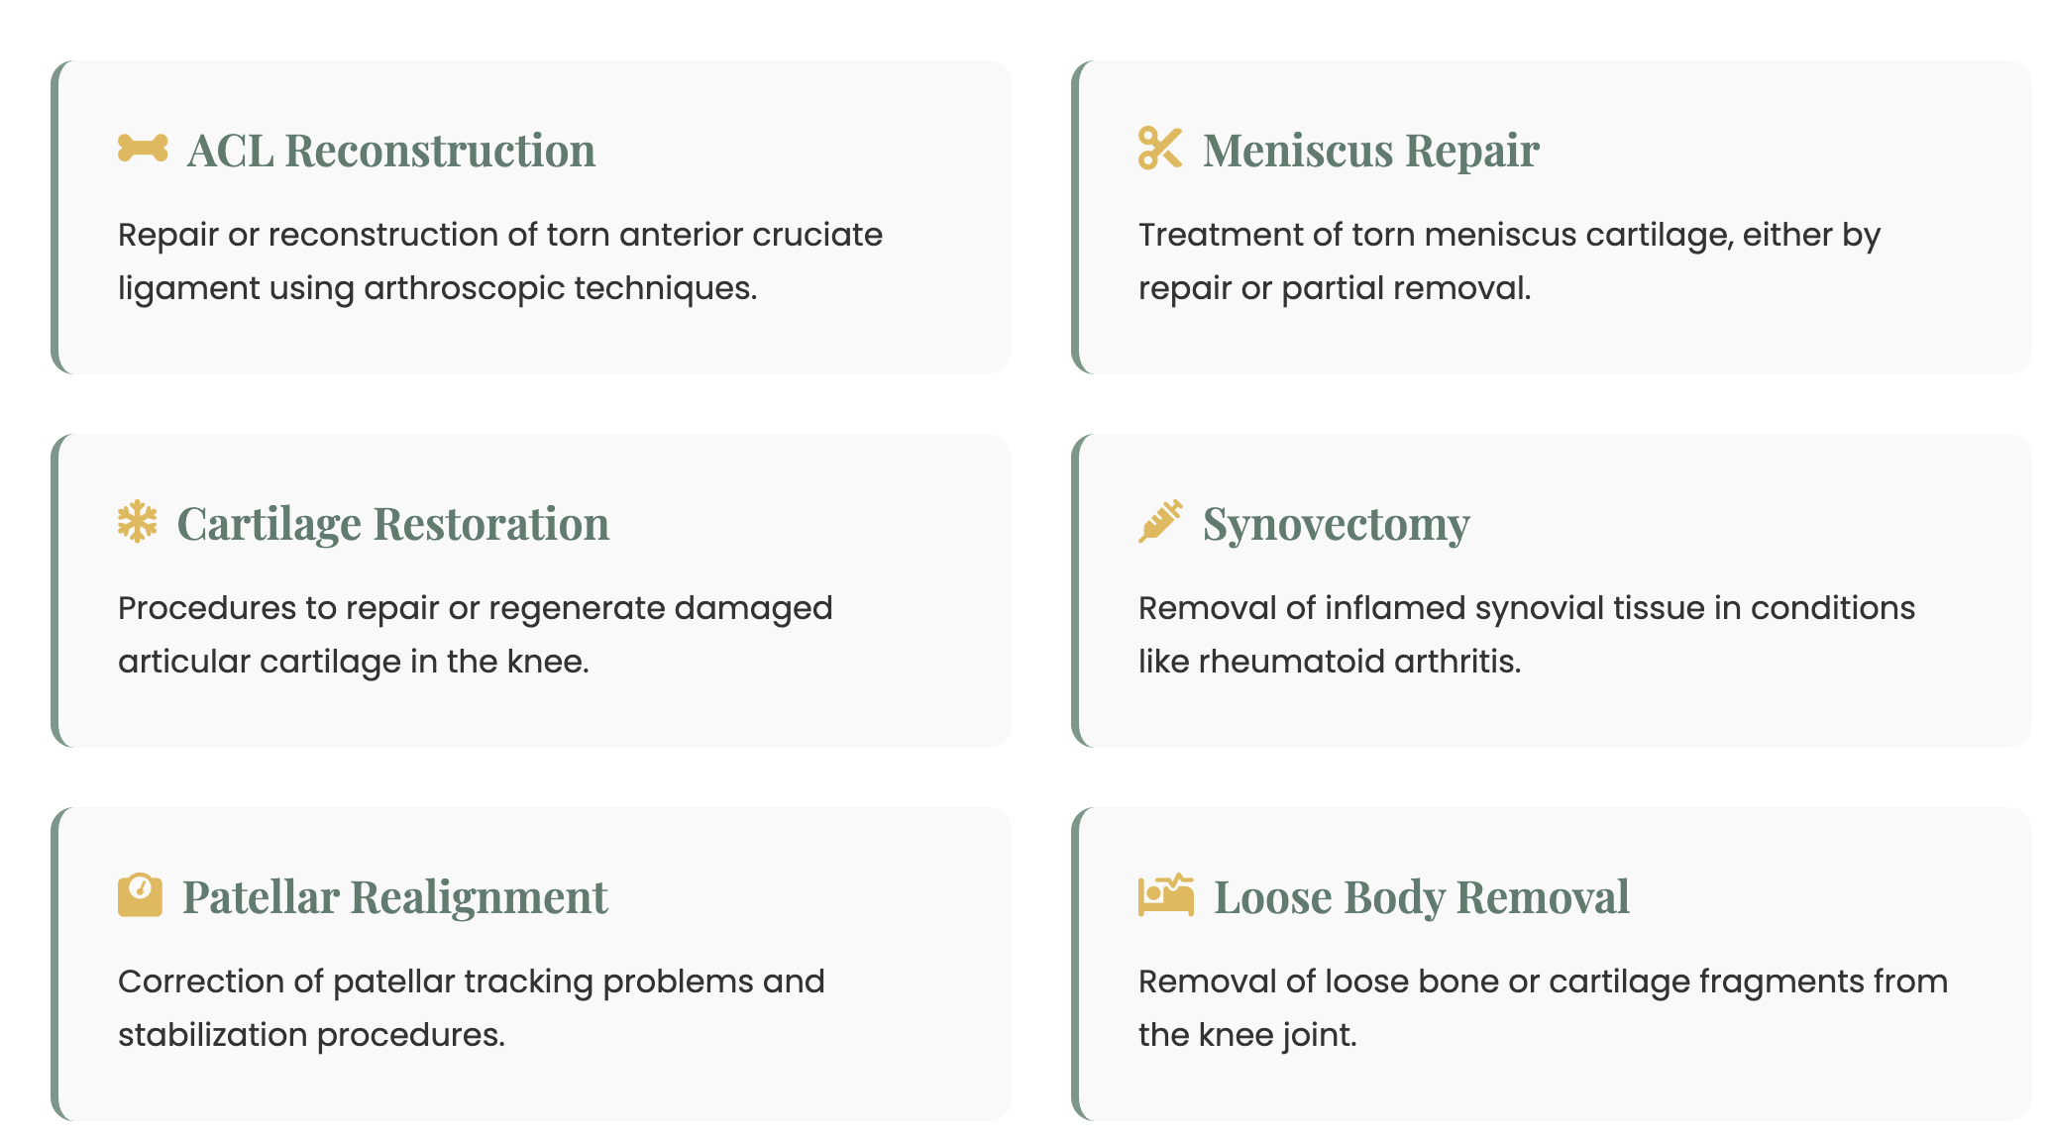
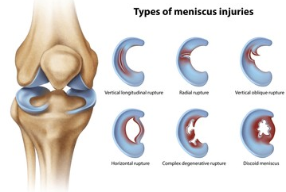
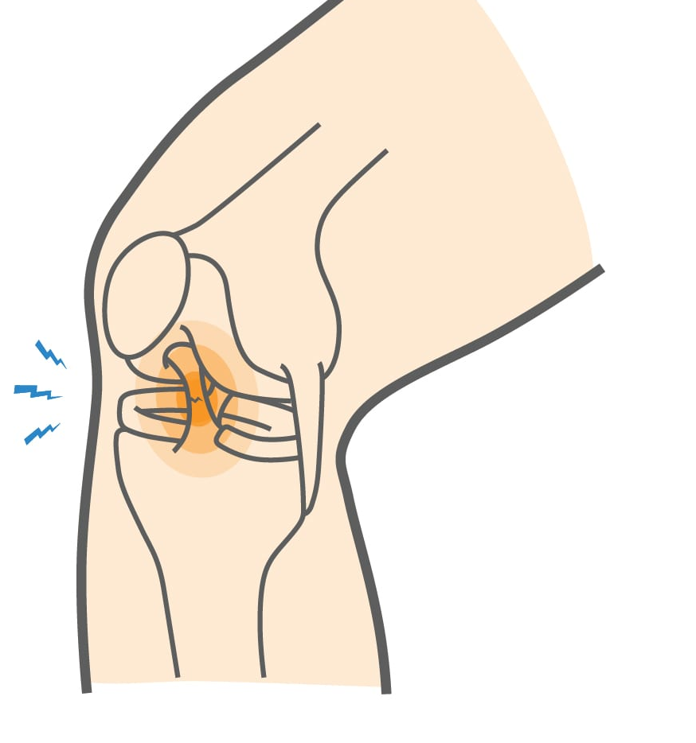
Treatment of torn meniscus either by repair or balancing
ACL clip art

Slide 13
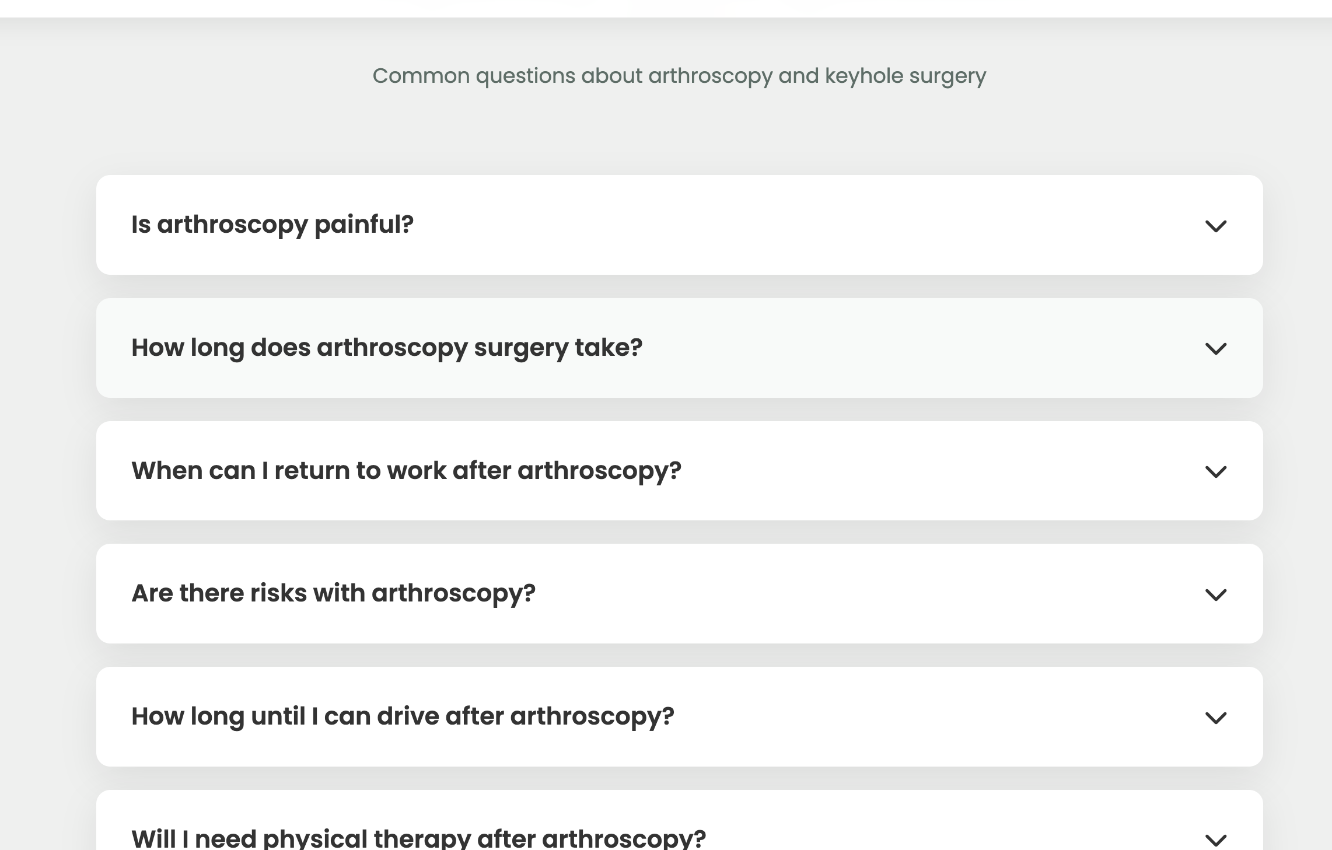
Why protein intake is importany after arthroscopy surgery
Protein intake is critical after arthroscopy surgery to promote efficient wound healing,
prevent muscle atrophy (loss) during inactivity, and rebuild tissues like tendons and ligaments

Slide 14
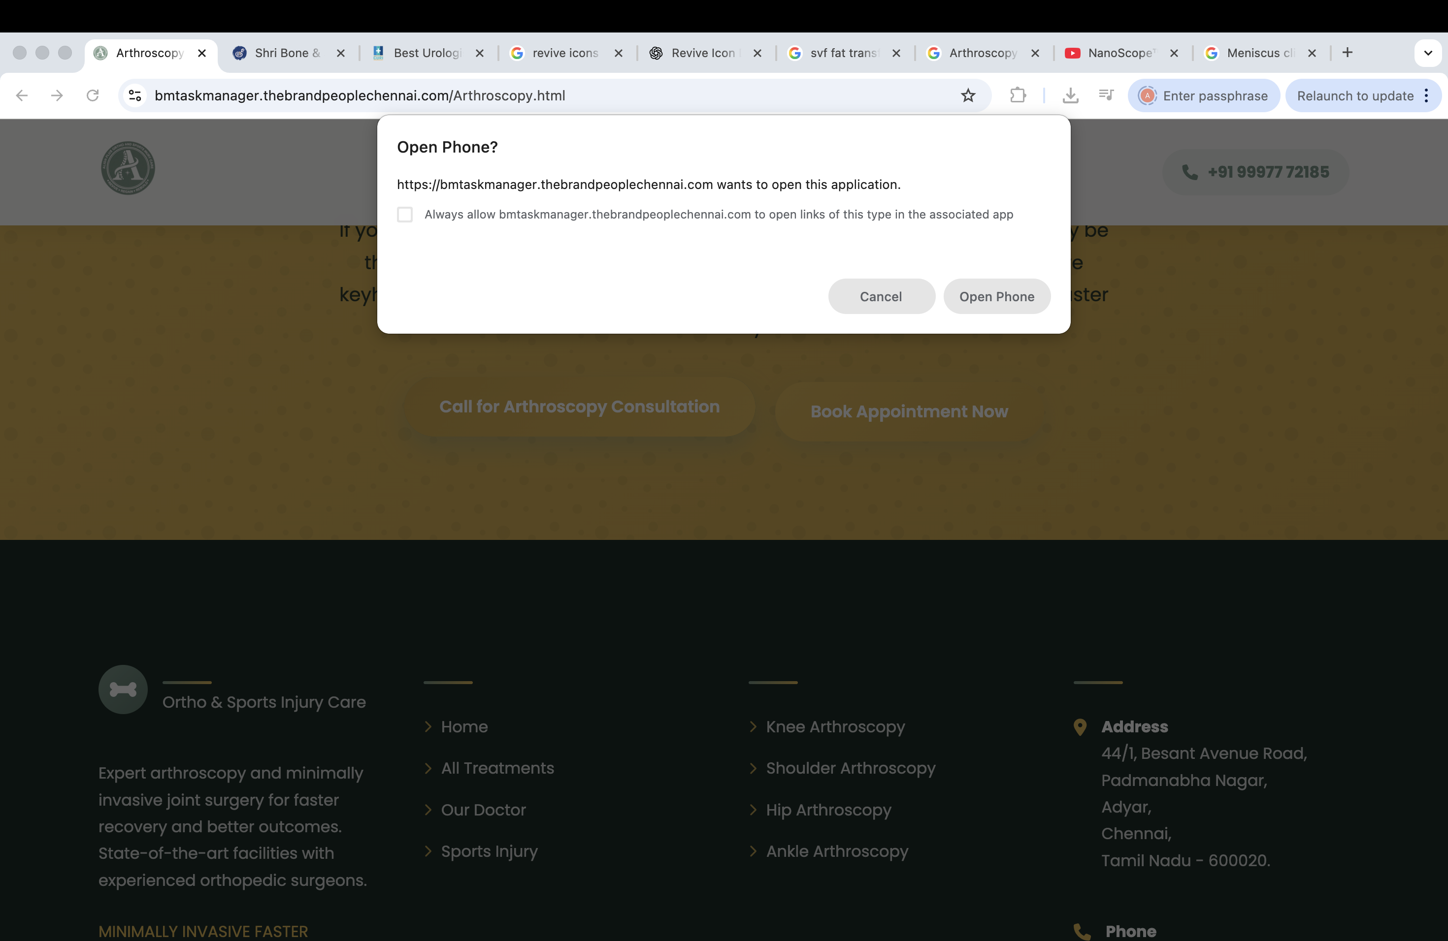
When I select call for arthroscopy appointment , Am getting this reposnse , What does it mean ??

Slide 15

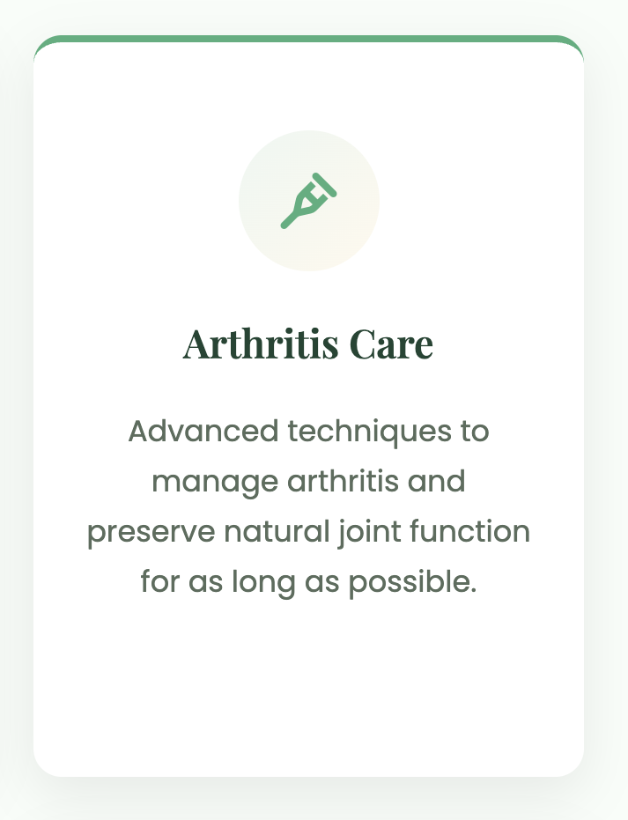
Arthritis care clip art

Slide 16
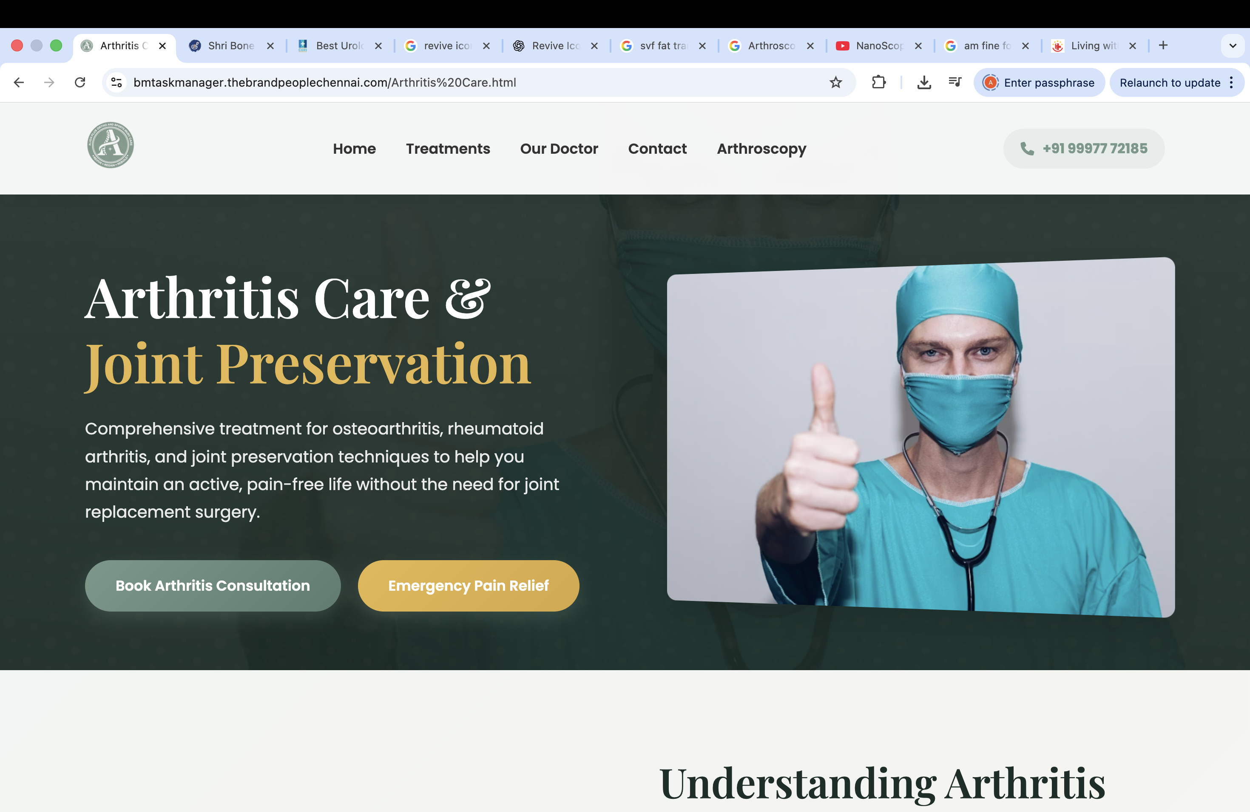


Slide 17
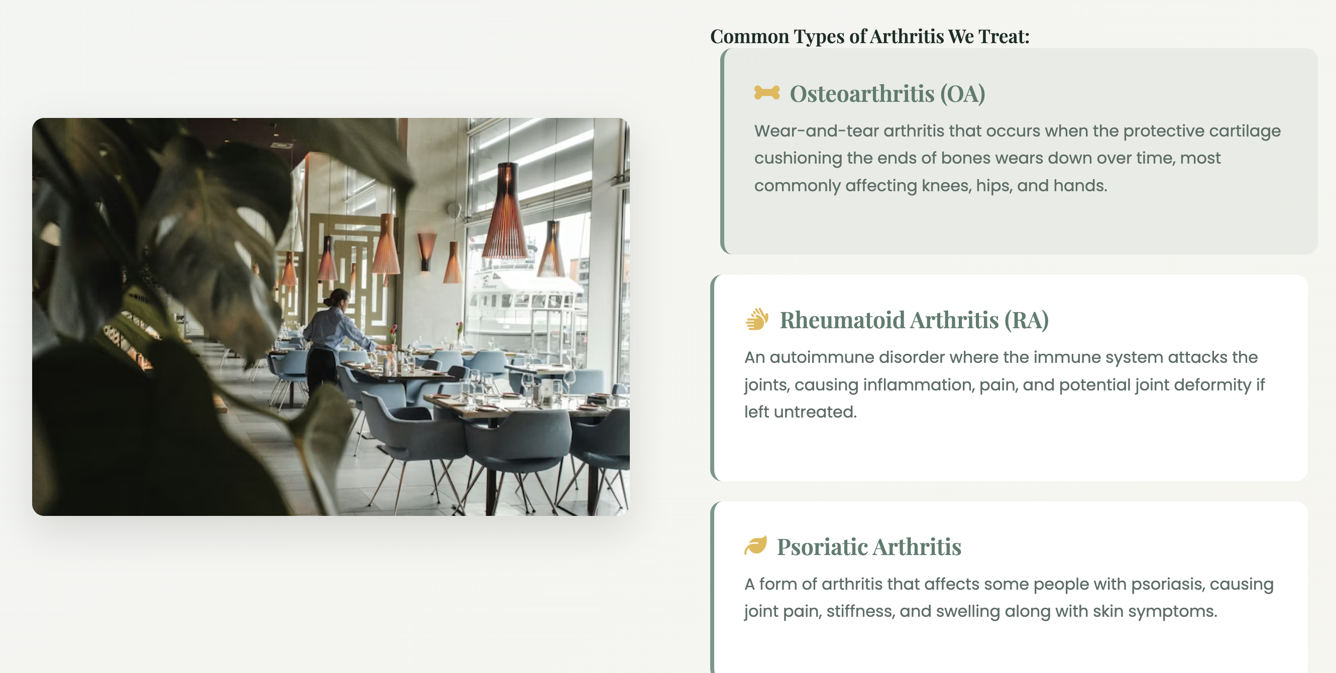

Why some restaurant image here?
Please remove this logo

Slide 18
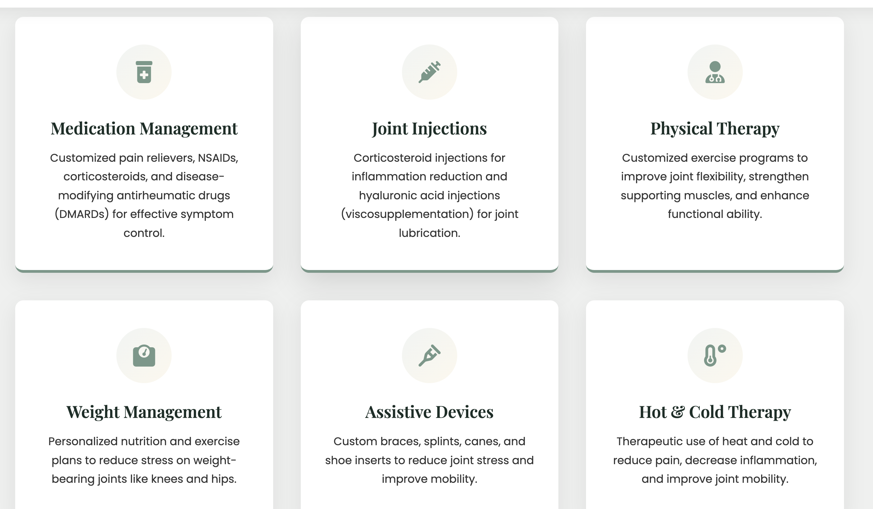
4th Joint injection
Hyaluronic acid injection ( Viscisupplementation) for joint lubrication and Regenrative injections
1st Medication management
Customized pain relivers and Supplements for effective symptom control
2nd Hot & Cold
3rd Physical

Slide 19
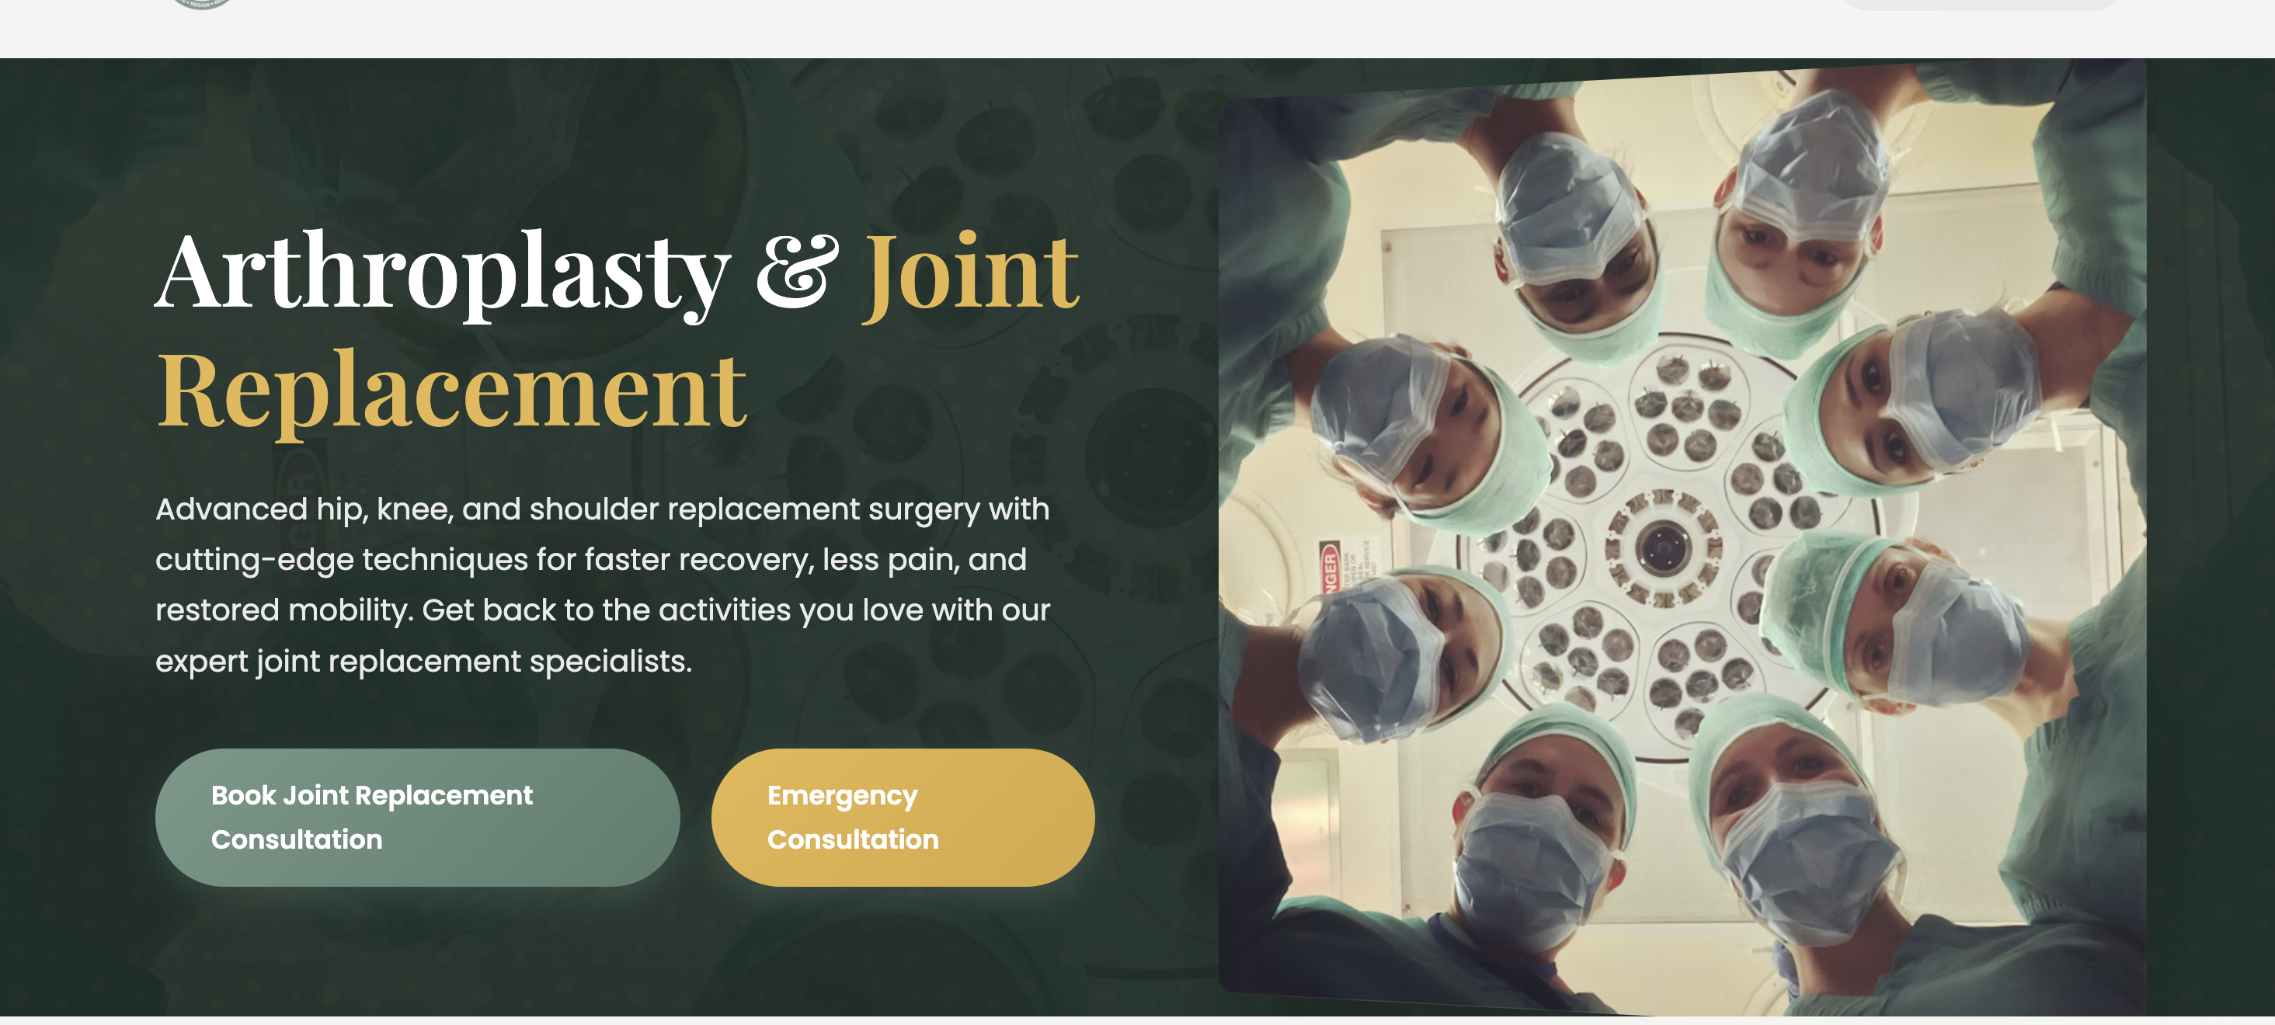
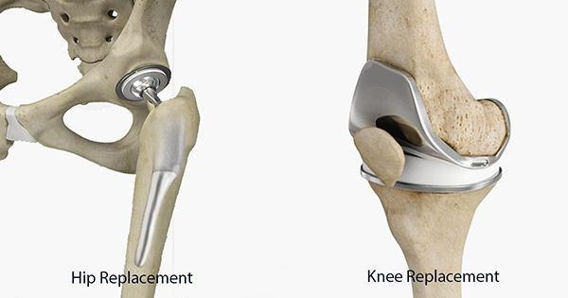

Slide 20
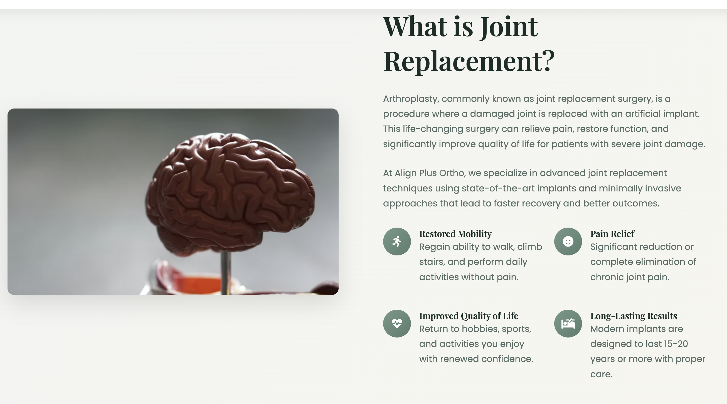
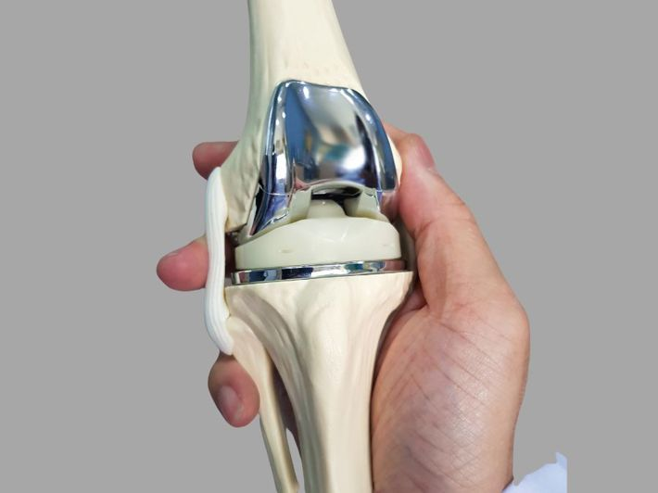
20 to 30 years

Slide 21
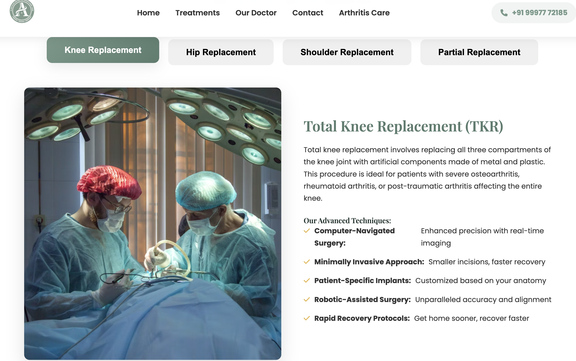
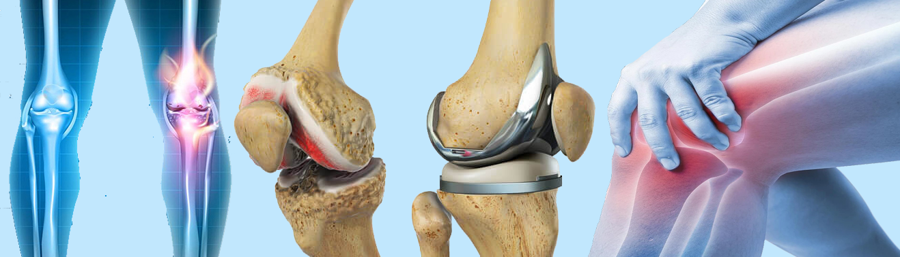
cobalt-chromium or titanium alloys for the femoral component and ultra-high molecular weight polyethylene (UHMWPE) for the tibial spacer

Slide 22
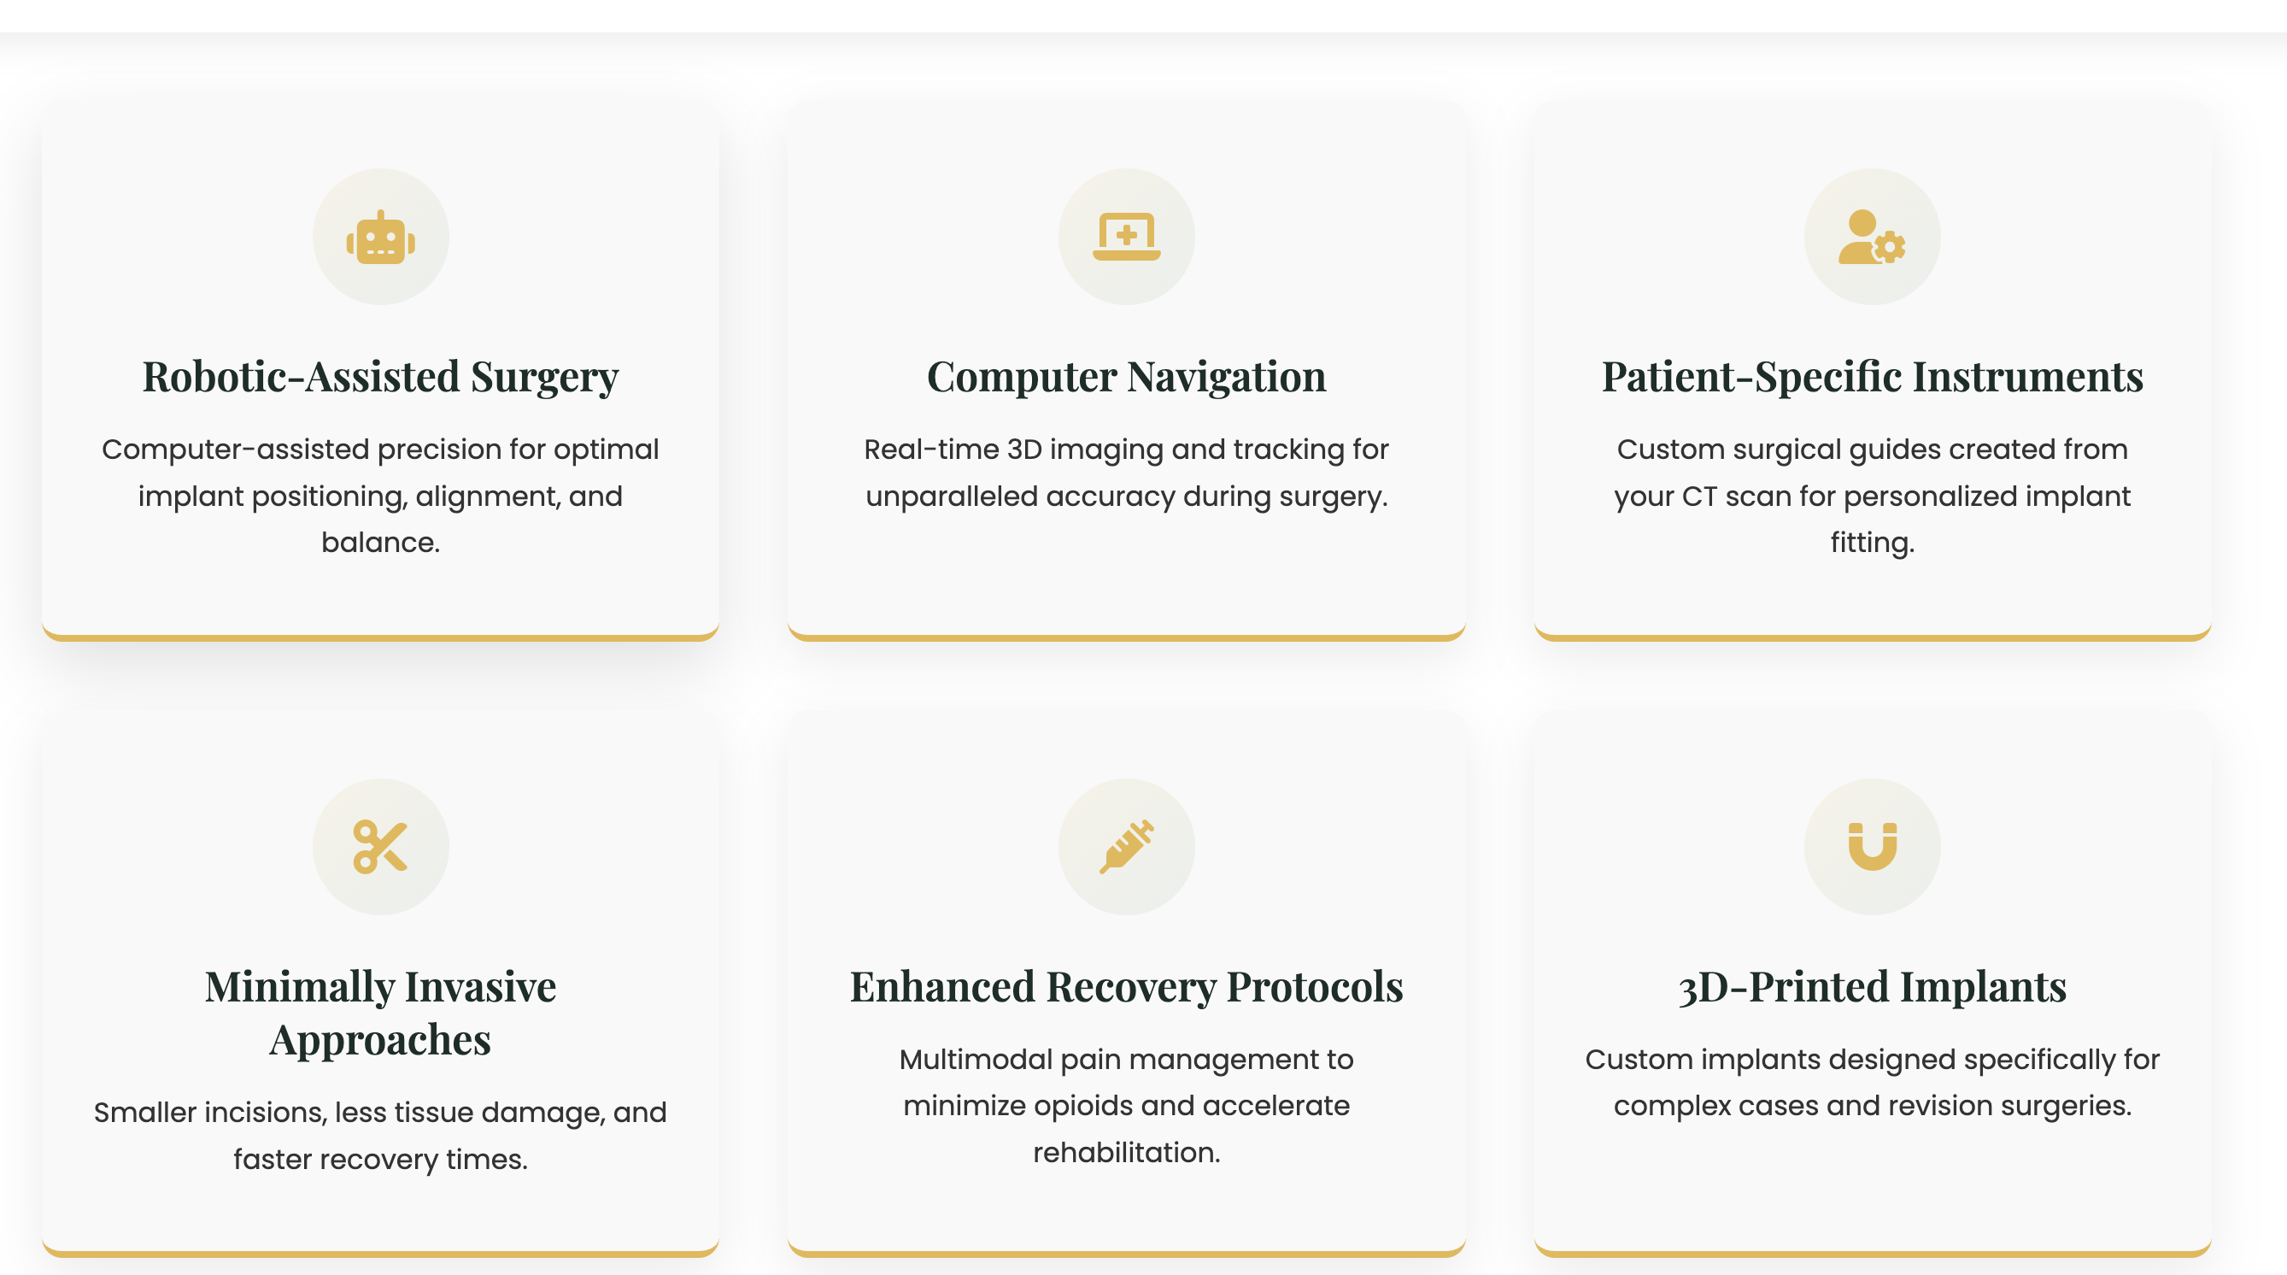


Minimally invasive surgical approach clip art
Robotic assisted surgery clip art

Slide 23
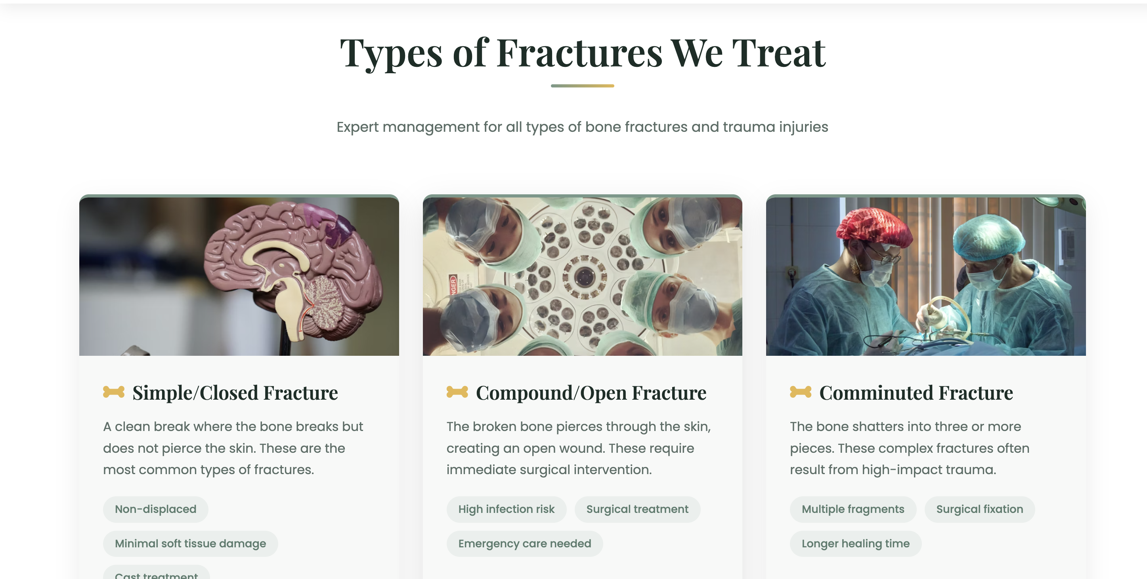

Under this type of fracture heading please add about pelvis and acetabular fracture as a separate focus

Slide 24
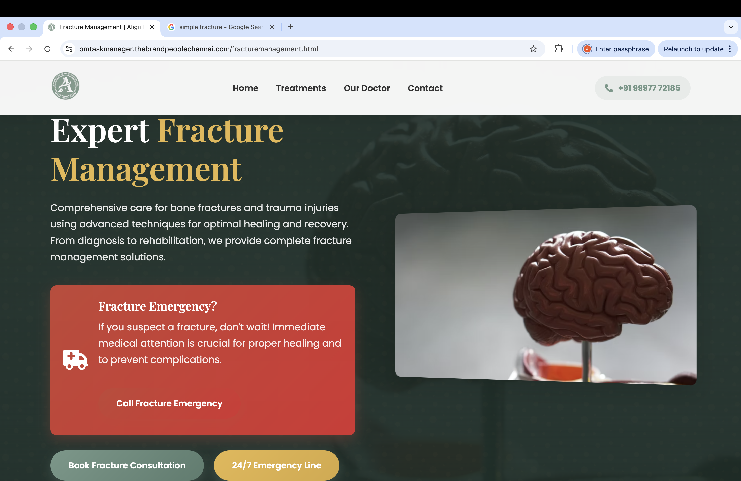


Slide 25
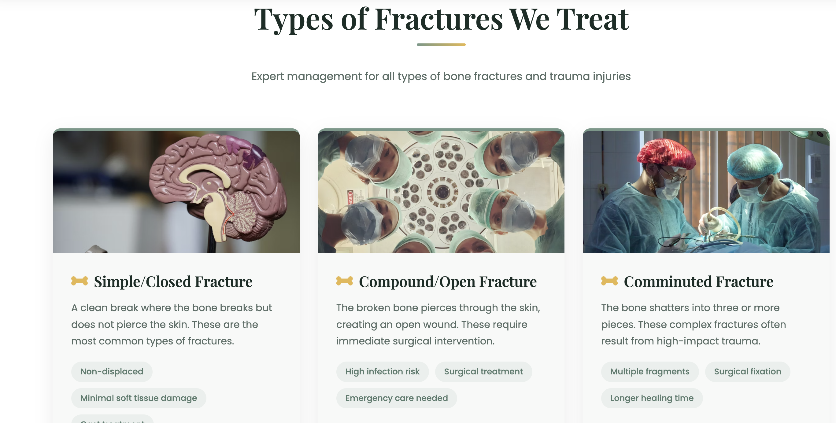
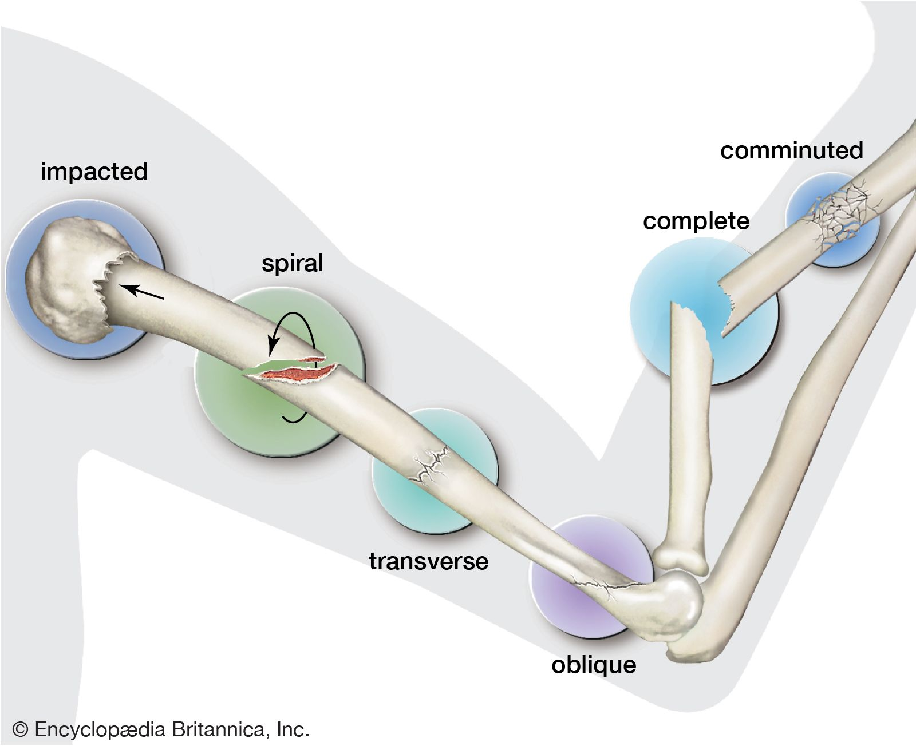

Slide 26
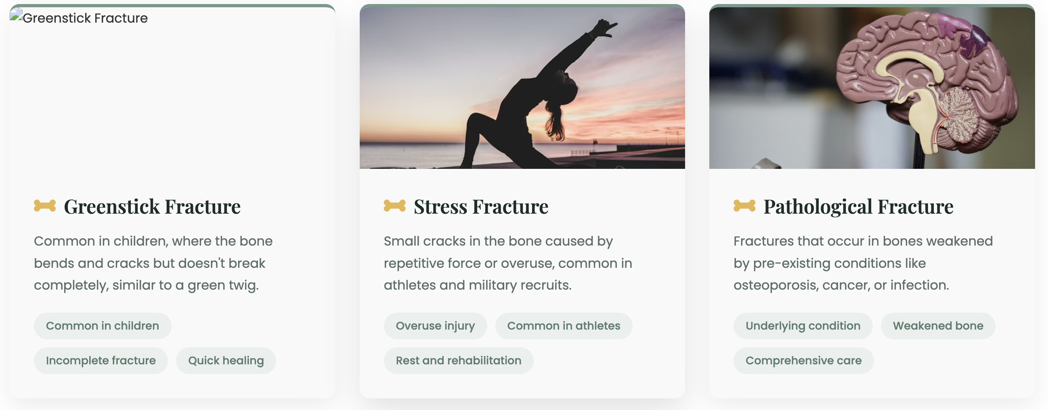
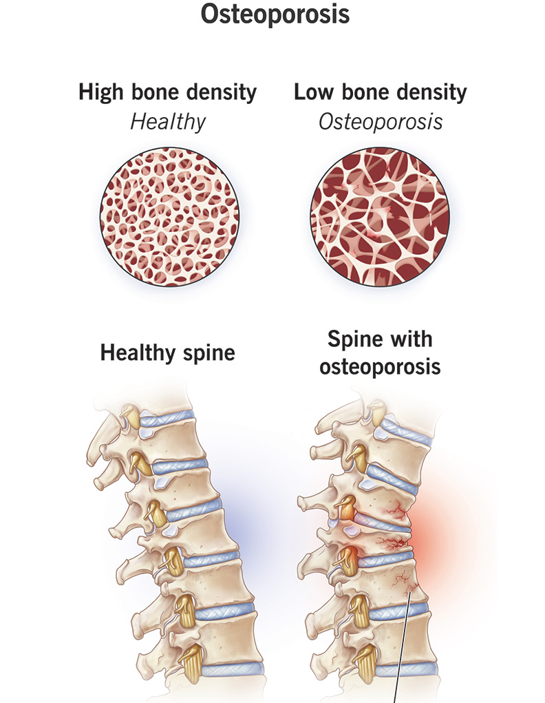
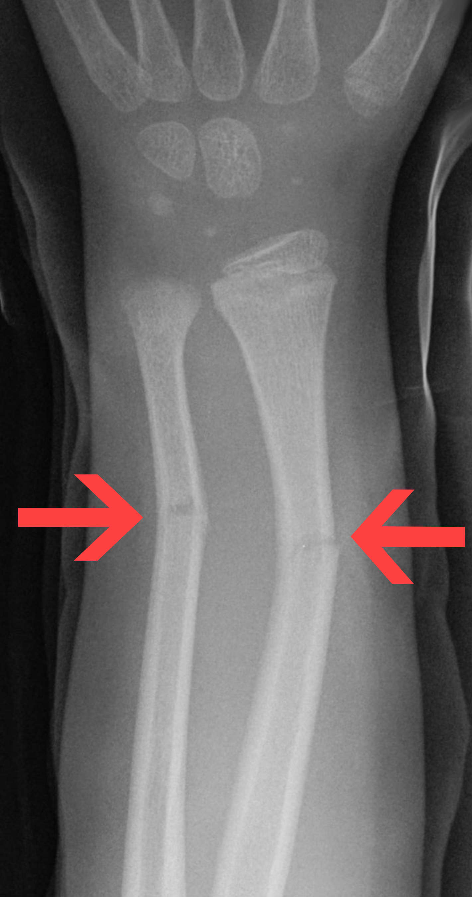
Pathological fracture
Green stick fracture

Slide 27
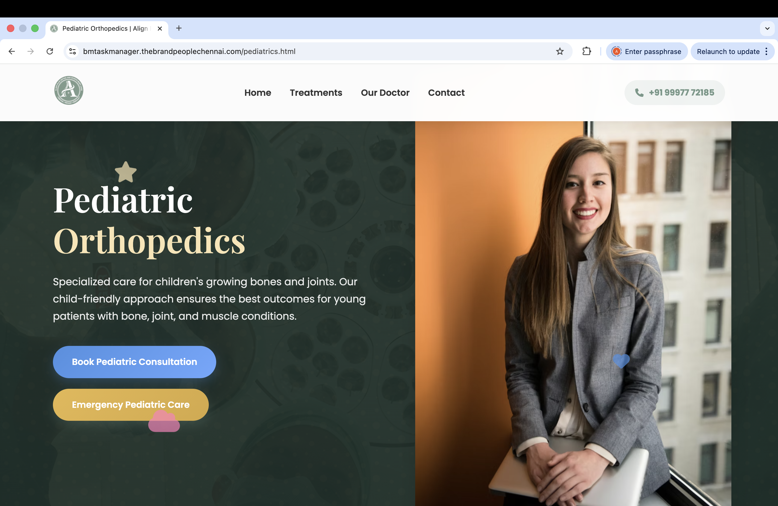


Slide 28
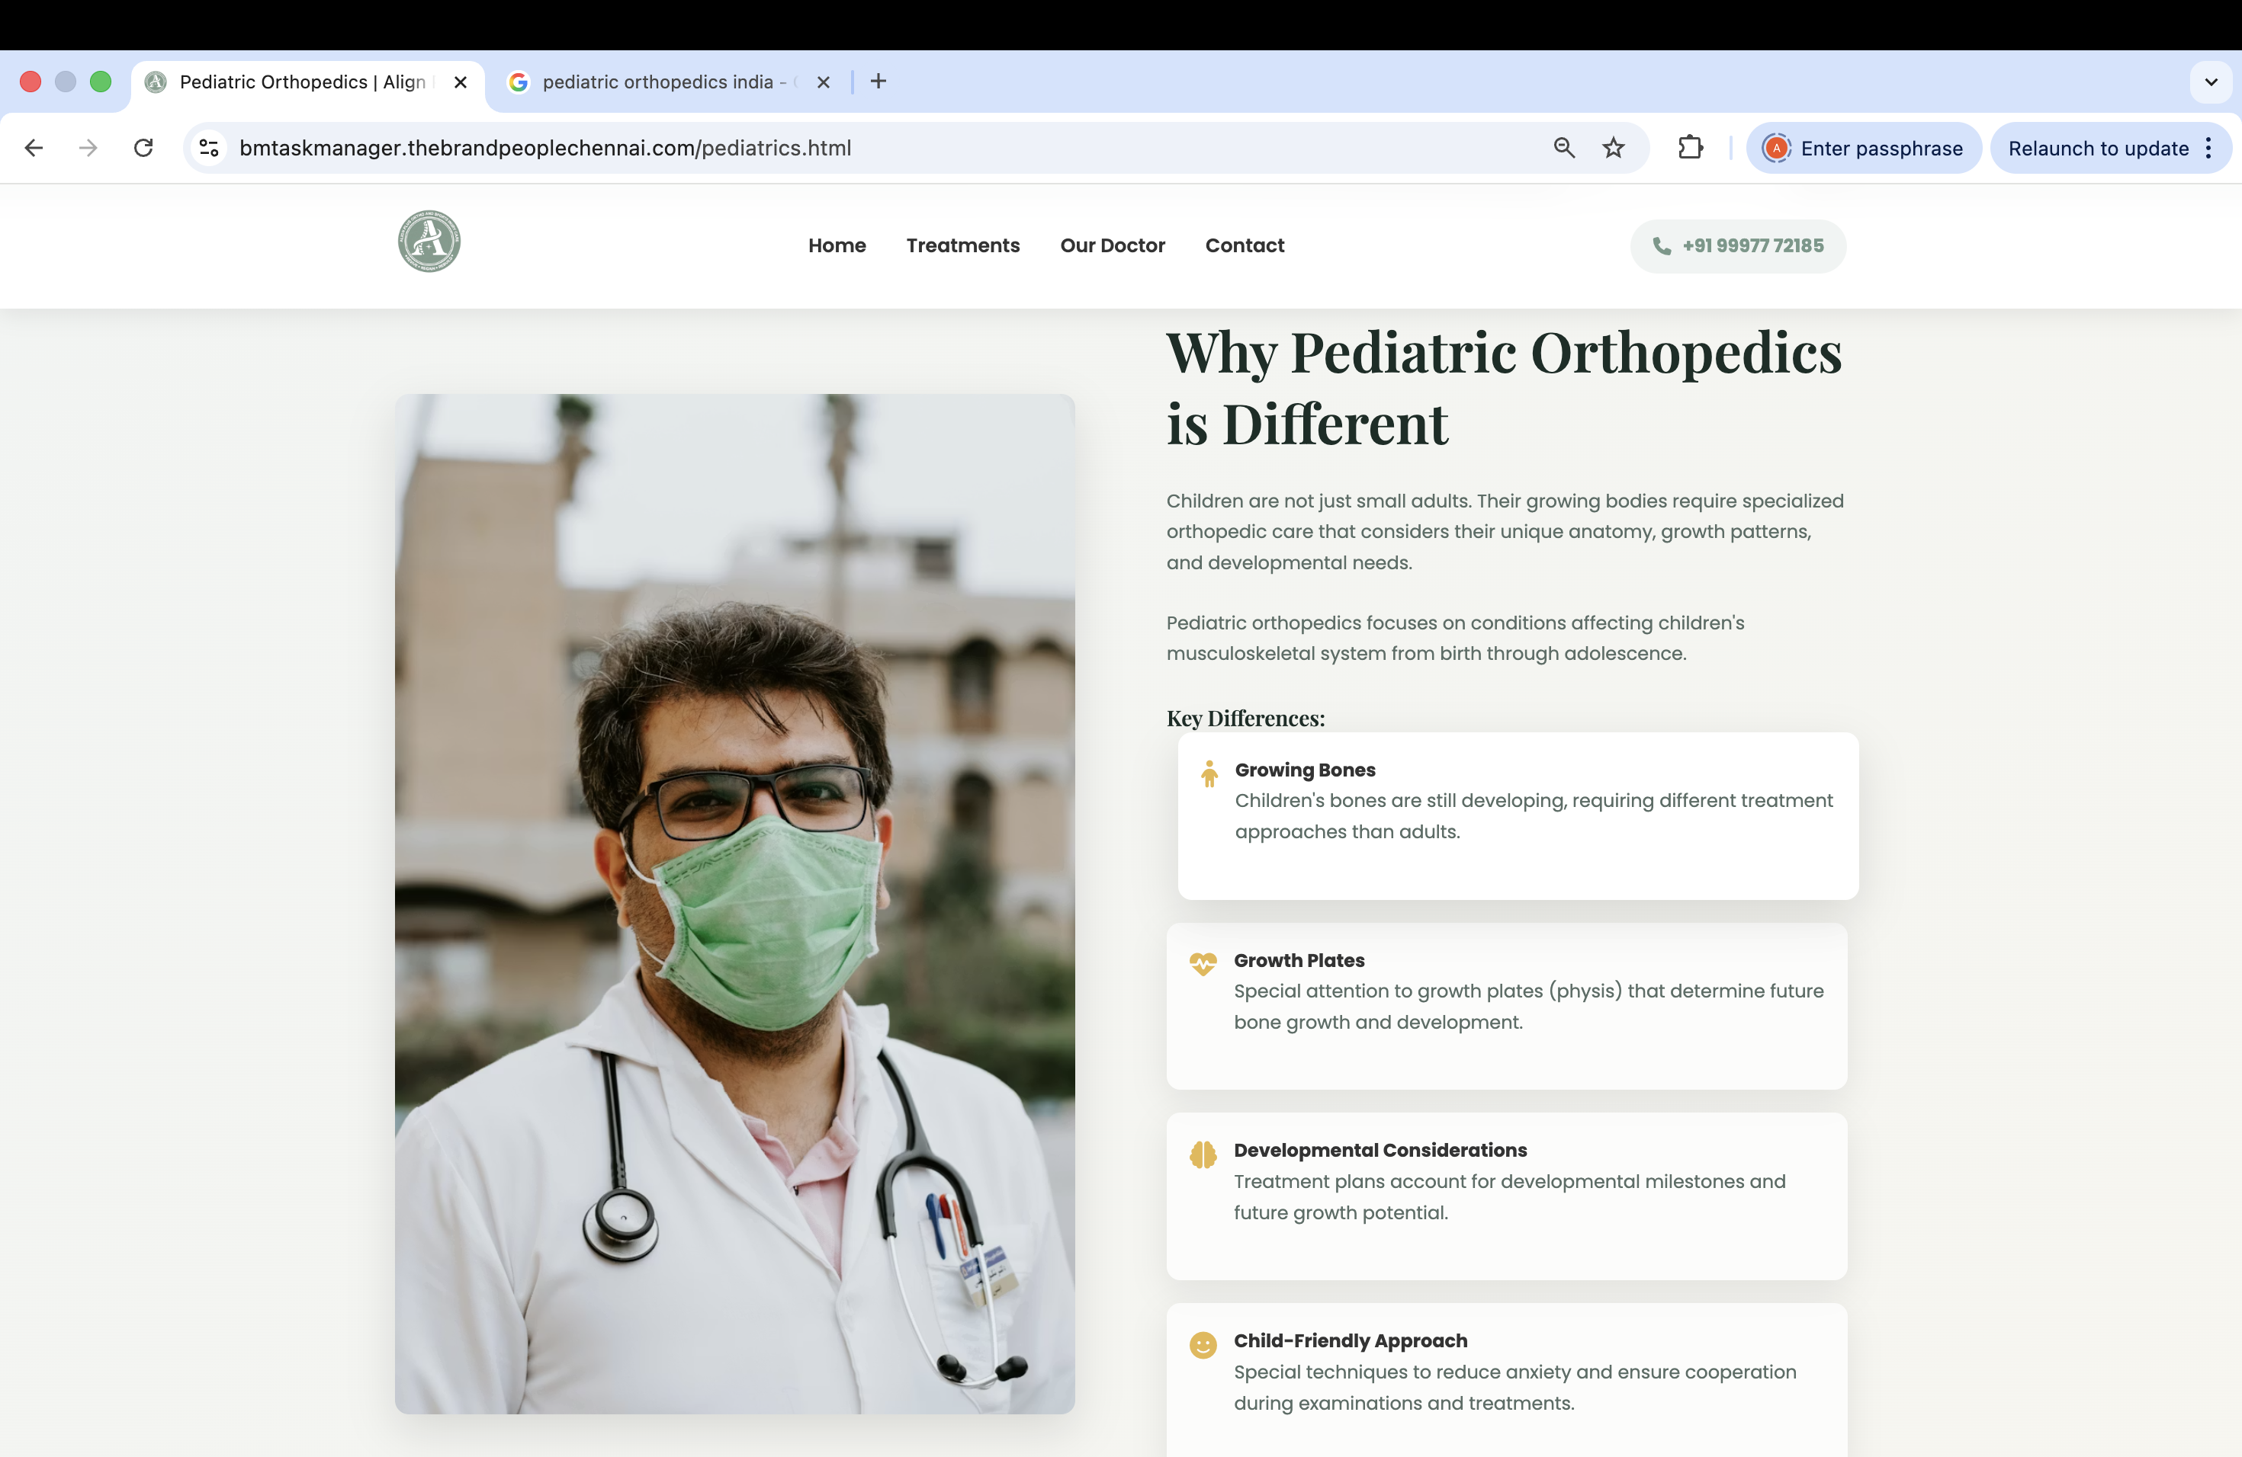
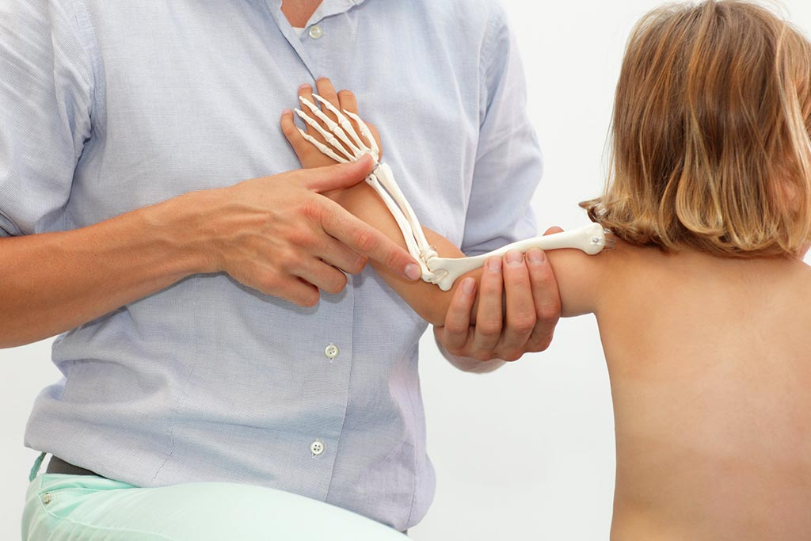

Slide 29
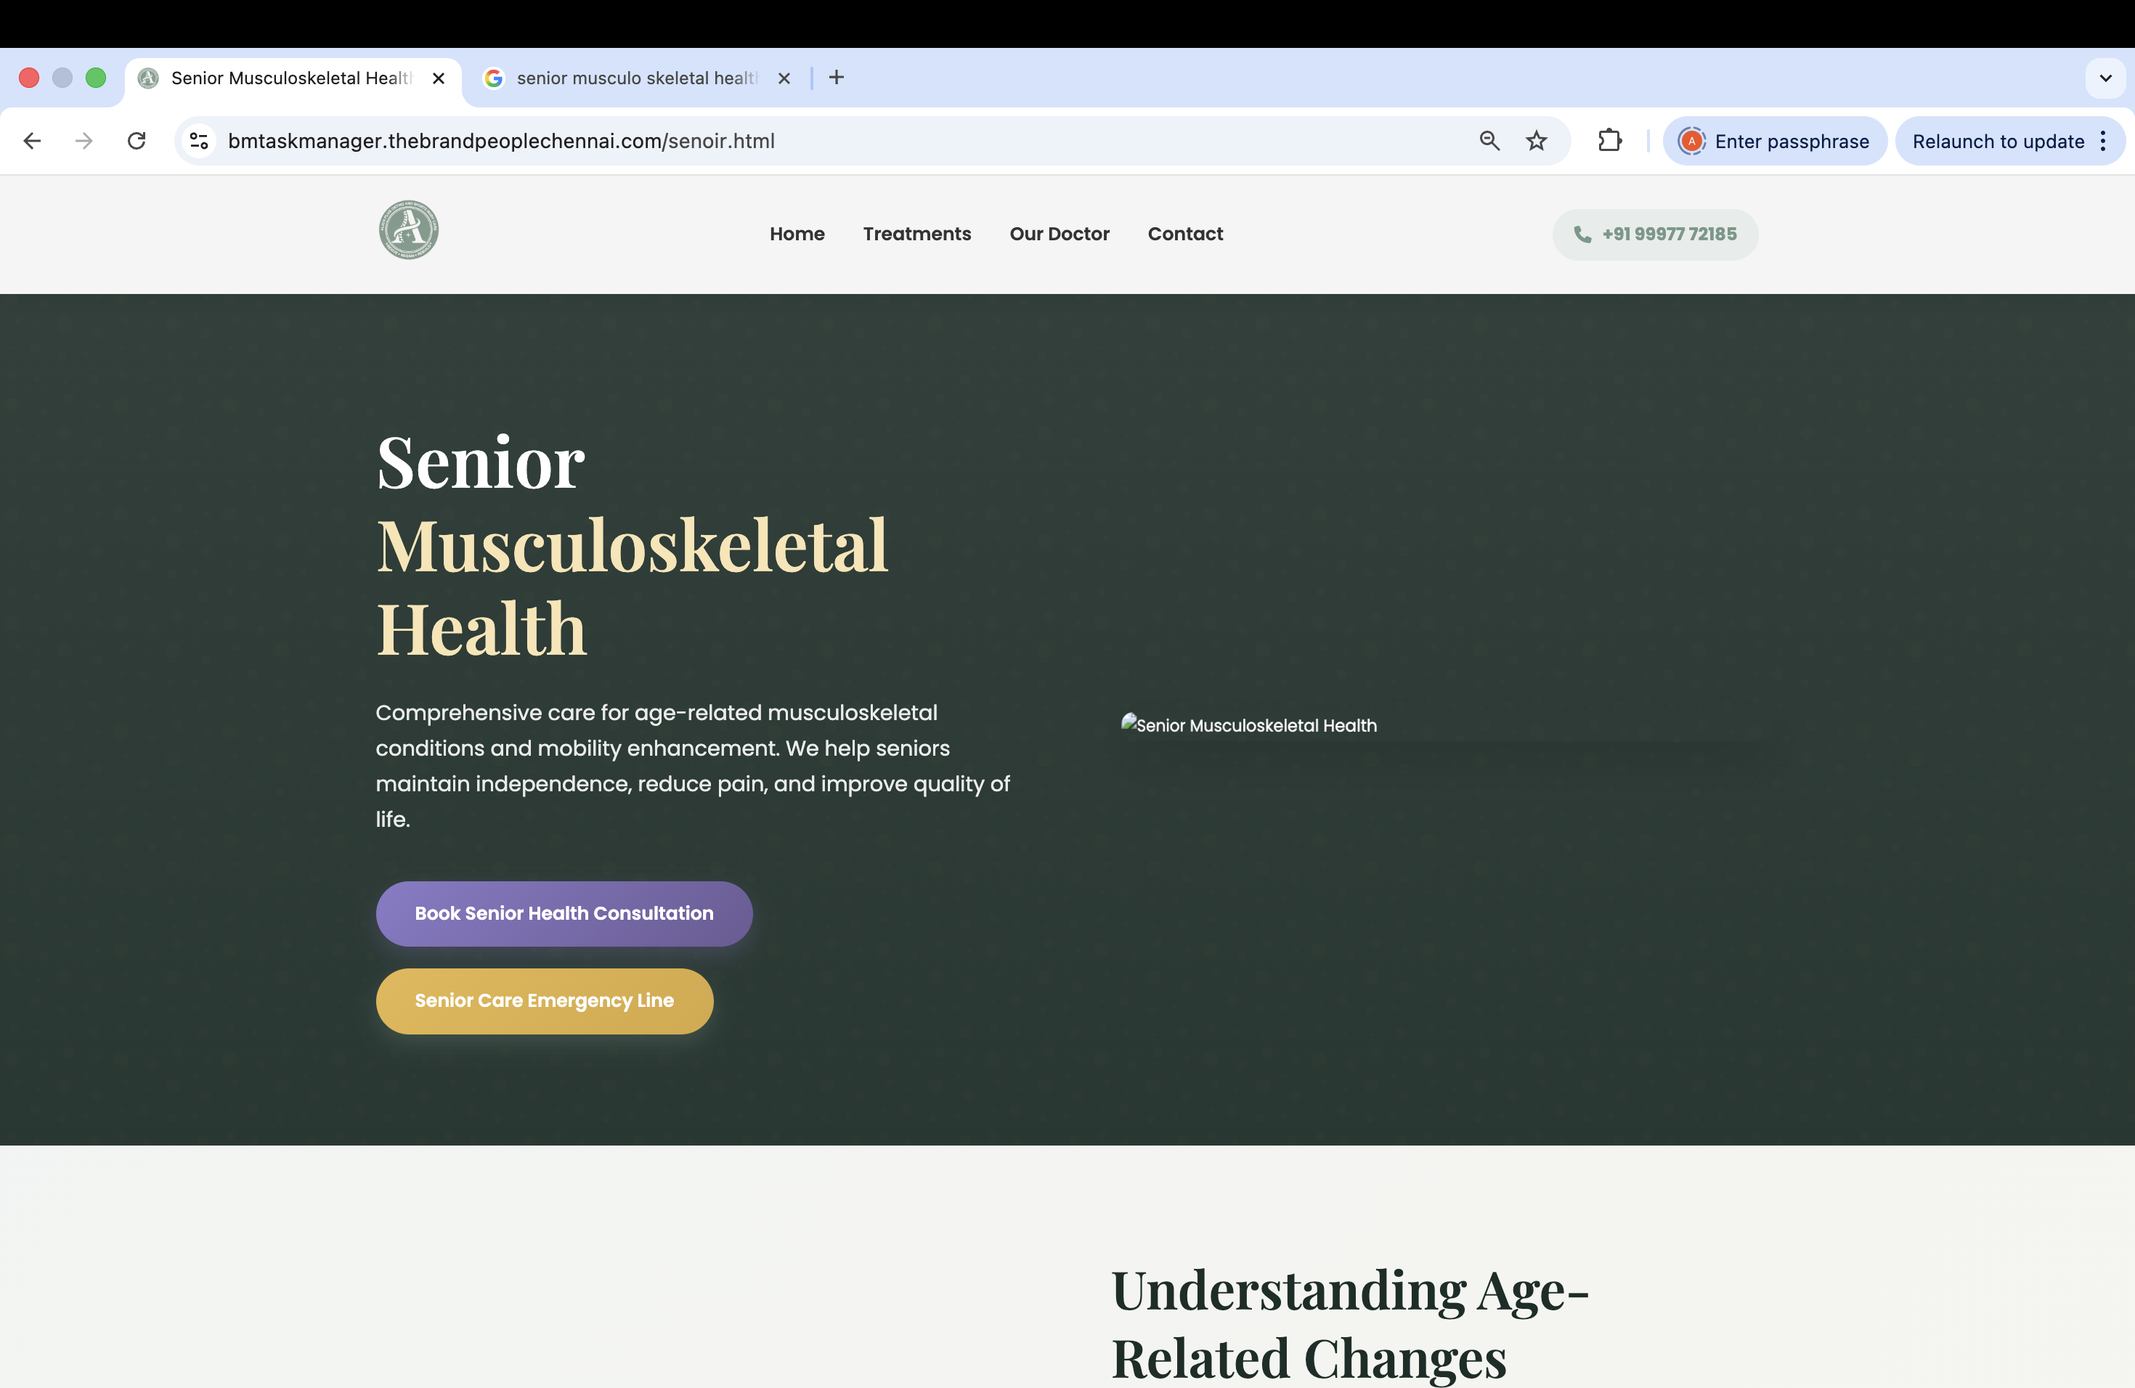


Slide 30
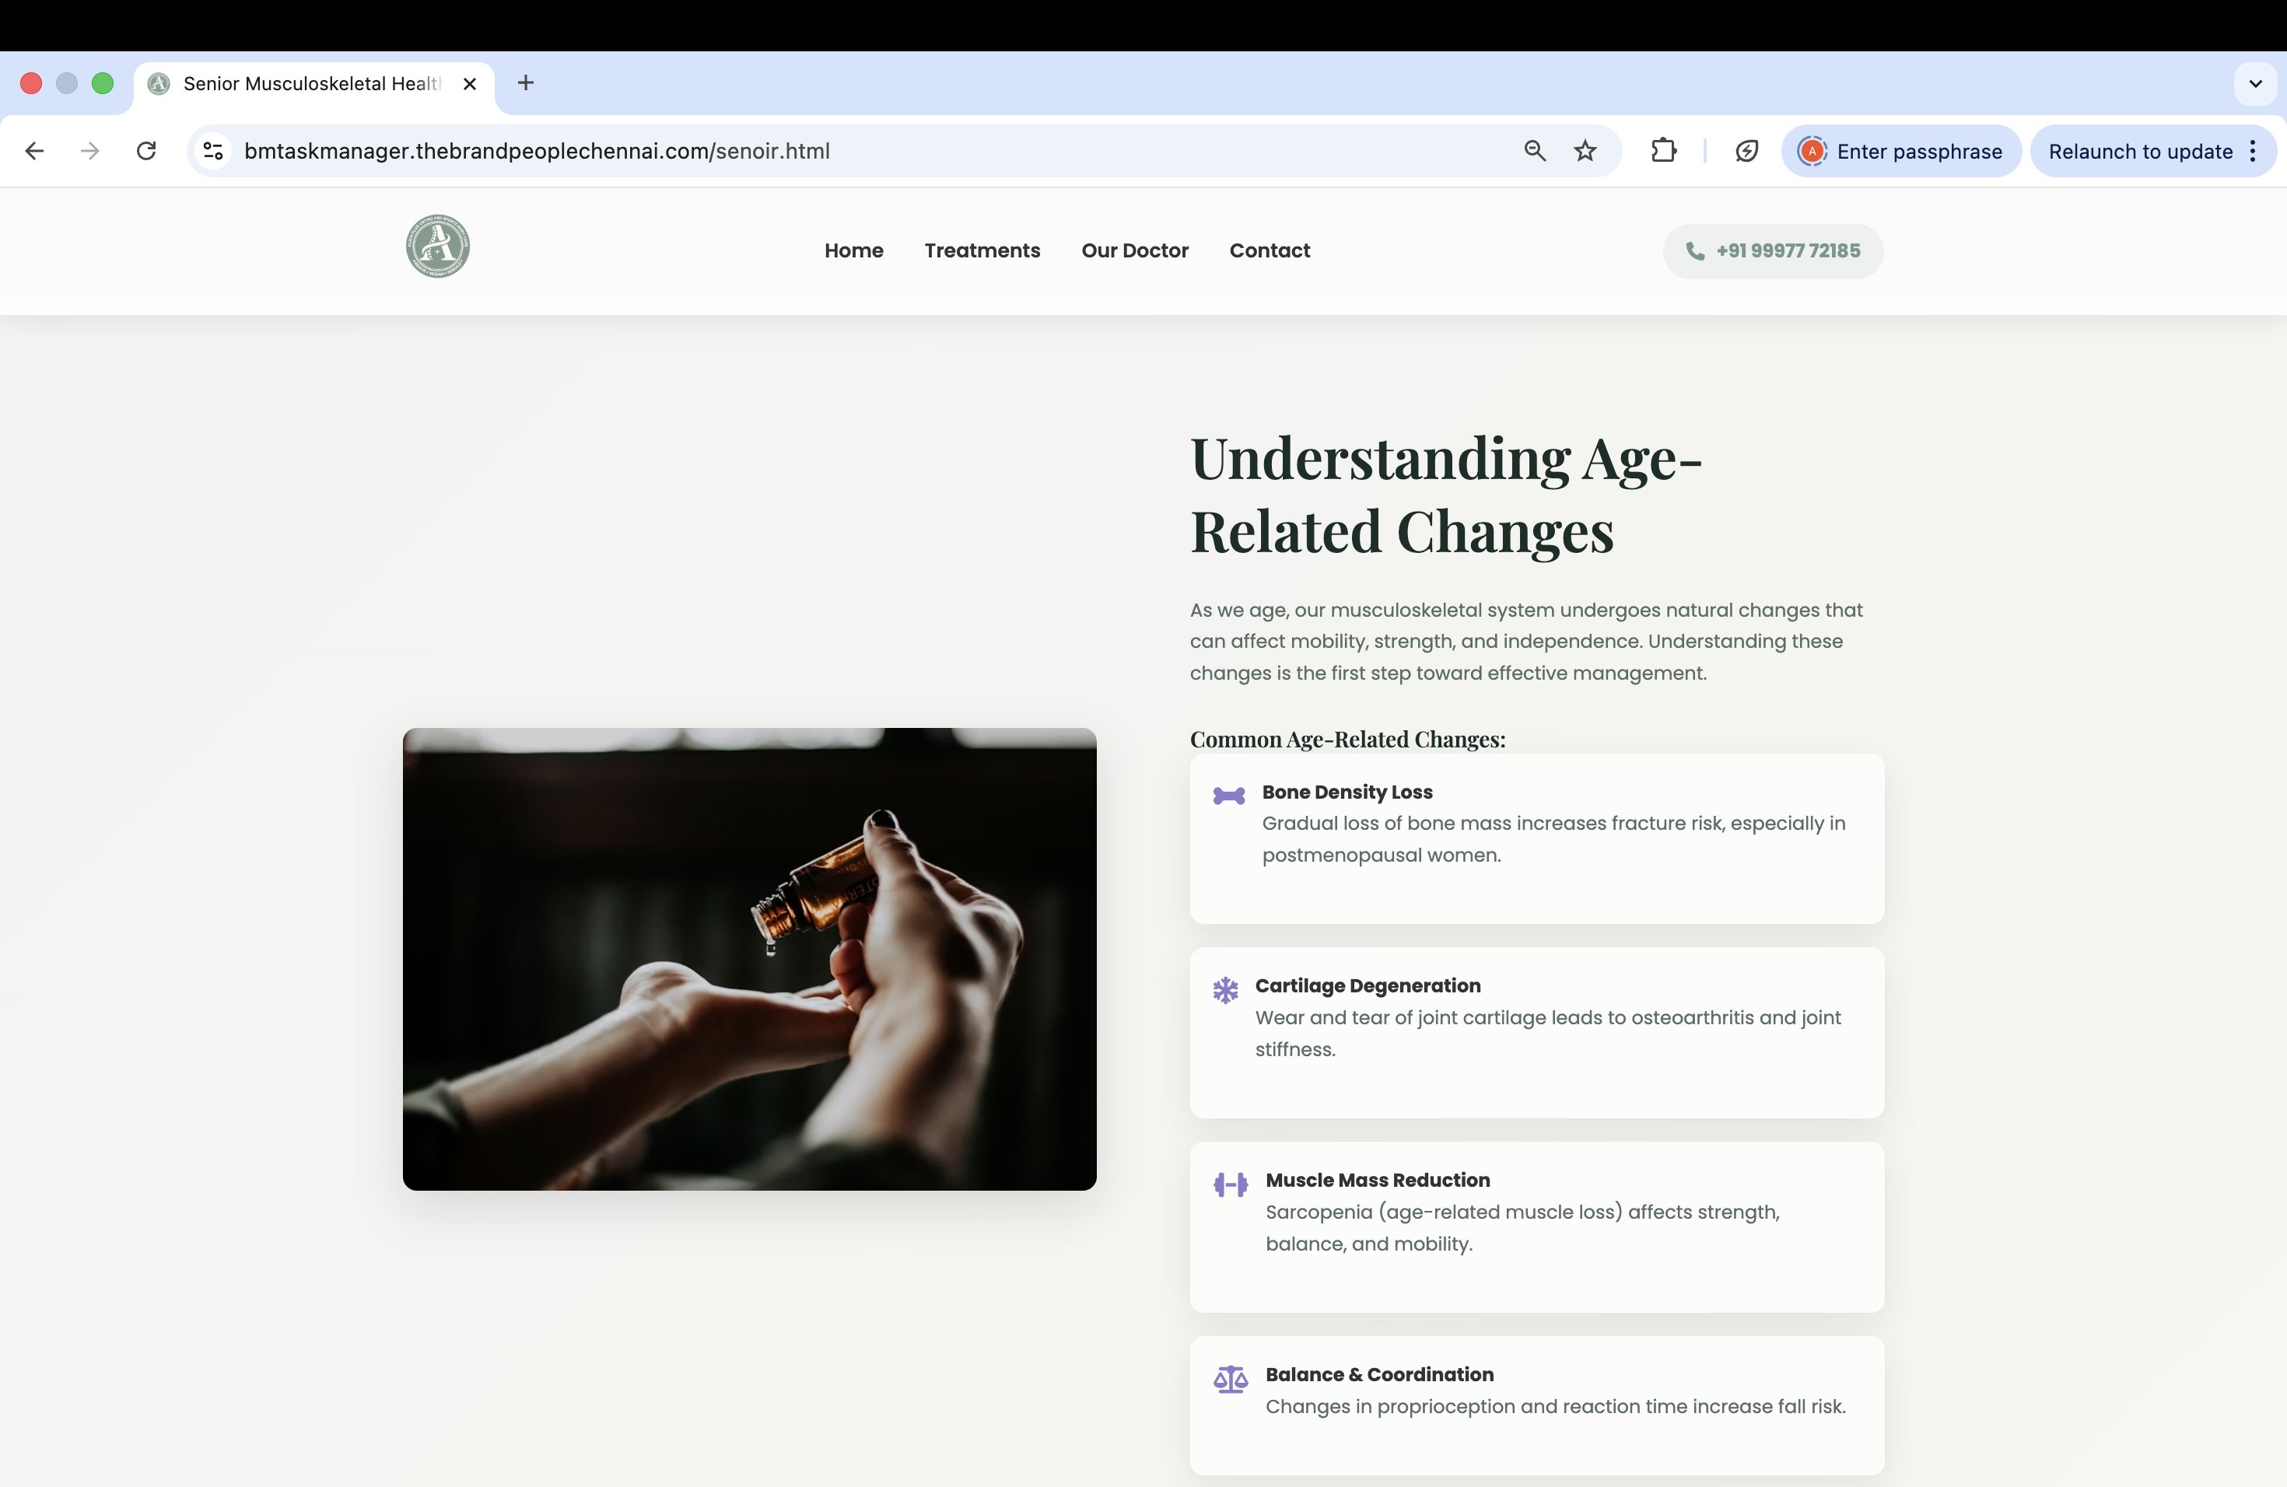


Slide 31
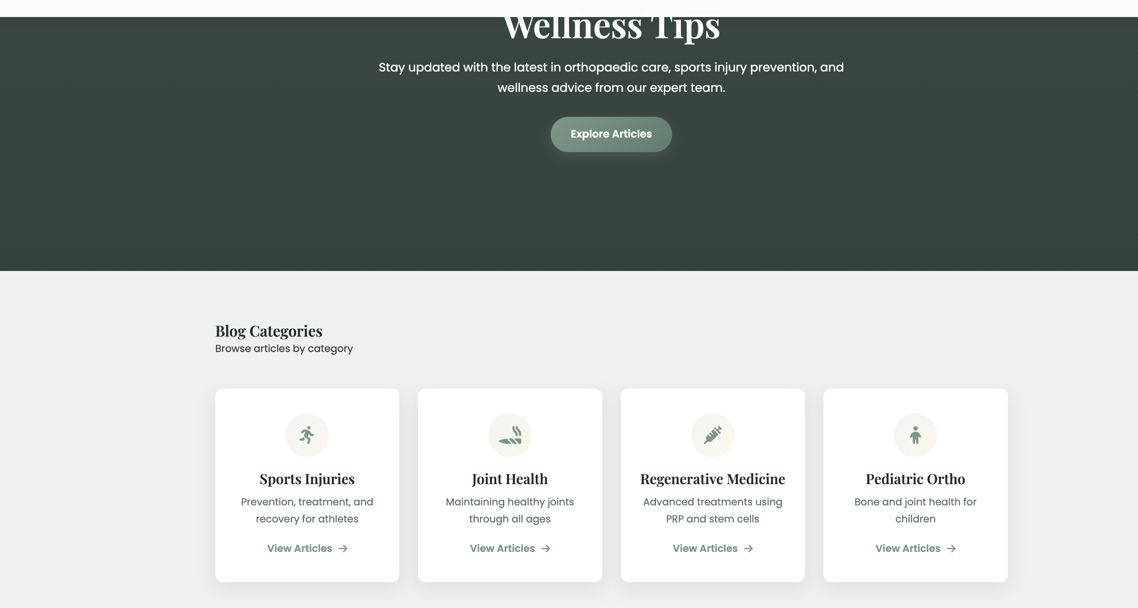
Read full article

